Slide 1


Cloud Operations on AWS
Module 3:
System Discovery
Lab 1
Notes:
|Instructor notes
|Student notes

Slide 2
Module overview
Course scenario
Methods to interact with AWS services
Tools for automating resource discovery
Inventory with AWS Systems Manager and AWS Config
Troubleshooting scenario
Lab 1: Auditing AWS Resources with AWS Systems Manager and AWS Config
Notes:
|Instructor notes
|Student notes

Slide 3
Example Corp. manager requests
AWS account resources must be inventoried.
Notes:
|Instructor notes
|Student notes
As different departments provision more AWS resources, the chief information officer (CIO) of your company wants to standardize access management, organize existing AWS accounts, and inventory AWS resources. Your manager wants you to design permissions templates for groups and roles in your team’s AWS accounts.
In addition, your manager wants a plan to best organize the company’s numerous AWS accounts. Your manager also wants an inventory of all your company’s current resources.

Slide 4

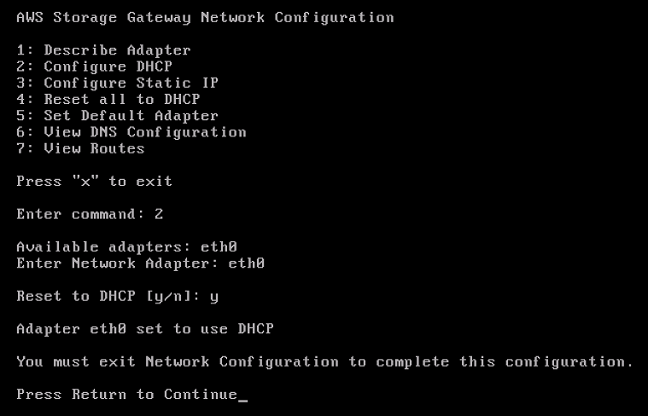
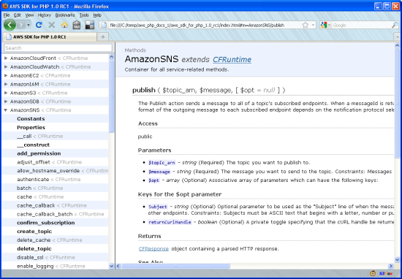
Interacting with AWS resources
AWS Management Console
Access AWS services from a convenient graphical interface.
AWS Command Line Interface (AWS CLI)
Access AWS services using a Linux, Windows, or macOS command line.
SDKs
Call AWS services APIs from most major programming languages. (Python, Ruby, .NET, Java)
Notes:
|Instructor notes
|Student notes
You can create and manage resources on the AWS Cloud in three ways. All three options are built on a common, REST-like API that serves as the foundation of AWS.
AWS Management Console
The console provides a rich graphical interface to most of the features that AWS offers.
AWS CLI
The AWS Command Line Interface (AWS CLI) provides a suite of utilities that can be launched from a command program in Linux, macOS, or Windows.
SDKs
AWS provides packages to access AWS in a wide variety of popular programming languages, so you can readily use AWS in your existing applications. You can create applications to deploy and monitor complex systems entirely through code.
AWS CLI and the SDKs provide flexibility. With AWS CLI and the SDKs, you can create your own tools specific to your business and customize existing AWS features. For example, you might create your own scripts or applications for the following common tasks:
Launching Amazon Elastic Compute Cloud (Amazon EC2) instances that enforce using a specific set of Amazon Machine Images (AMIs)
Adding a standard set of tags
You can use all modes of access interchangeably. For example, an Amazon EC2 server can be managed as follows:
Created by using an SDK call
Described by using the appropriate command line call, such as aws ec2 describe-instances
Terminated from the AWS Management Console
It might take a few seconds or a few minutes for changes made through AWS CLI or the API to surface in the console.

Slide 5
Methods to interact with AWS services
Notes:
|Instructor notes
|Student notes

Slide 6

Introduction to AWS CLI
Available for Linux, Windows, and macOS
To specify defaults values, use the aws configure command to include the following:
Access key and secret access key (Optional, if you use an instance profile)
Region name
Output format
AWS CLI
Notes:
|Instructor notes
|Student notes
Let’s review some of the basics of the AWS CLI. The AWS CLI is available for use on Linux, Windows, and macOS platforms. You can install it on Linux and Windows EC2 instances.
To set defaults for AWS CLI commands, you can run the aws configure command on servers hosting the AWS CLI. For example, these commands include the access key ID and the secret access key associated with the AWS Identity and Access Management (IAM) account that accesses AWS resources. You can also specify a default AWS Region for all commands.
For more information, see “Install or Update the Latest Version of the AWS CLI” in the AWS Command Line Interface User Guide at https://docs.aws.amazon.com/cli/latest/userguide/cli-chap-install.html.

Slide 7

Command line format
Amazon EC2
aws ec2 stop-instances --instance-id i-1234567890abcdef0 --output json
Service
Operation
Parameters
Options
aws ec2 run-instances –-cli-input-json file://webserver.json
$ aws help
$ aws ec2 help
$ aws ec2 describe-instances help
Notes:
|Instructor notes
|Student notes
The basic structure of an AWS command line call is the aws command, followed by these main elements:
Command – This is the top-level service that you are calling, for example, Amazon EC2 or Amazon CloudWatch. For a list of supported services, see AWS CLI Command Reference at http://docs.aws.amazon.com/cli/latest/reference.
In the example, the command lines at the bottom call the Amazon EC2 service.
Subcommand – This is the operation to perform on that service, for example, run-instances or put-metric-data. In this Amazon EC2 example, the run-instances subcommand requests the creation of a new Amazon EC2 instance.
Parameters – These are any arguments required to perform the operation. Argument names are preceded by two dashes (--). For example, to perform the Amazon EC2 run instances operation, pass in parameters, such as the AMI ID, to create the instance.
Options – AWS CLI also provides options that you can specify when running the operation. For example, you can use the --query option to limit the response text, so it returns only the instance ID of your new instance.

Slide 8
AWS CLI option: --dry-run
Checks whether you have required permissions for the action, without actually making the request
Provides an error response
aws ec2 run-instances --image-id ami-1a2b3c4d --count 1 --instance-type c5.large --key-name MyKeyPair --security-groups MySecurityGroup --dry-run
Notes:
|Instructor notes
|Student notes
The --dry-run option checks whether you have the required permissions for the action, without actually making the request.
The option also generates an error response. If you have the required permissions, the error response is DryRunOperation. Otherwise, it is UnauthorizedOperation.

Slide 9
Session Manager, a capability of AWS Systems Manager
Administrators do the following:
Connect securely to instances
Control access to instances
Track user activity in instances
AWS Systems Manager tools:
Session Manager
Notes:
|Instructor notes
|Student notes

Slide 10









Session Manager
AWS Cloud
VPC
Public subnet
Private subnet
Internet gateway
NAT gateway
Instance
(Windows or Linux)
Console
or AWS CLI
Session Manager
AWS PrivateLink
Interface endpoint
Notes:
|Instructor notes
|Student notes
Session Manager, a capability of AWS Systems Manager, is a fully managed service that you can use to manage your EC2 instances, on-premises instances, and virtual machines (VMs). You can do this through an interactive, browser-based shell or through the AWS CLI.
VPC endpoints – You can further improve the security posture of your managed instances by configuring Systems Manager to use an interface virtual private cloud (VPC) endpoint. Interface endpoints are powered by AWS PrivateLink. With the PrivateLink technology, you can privately access Amazon EC2 and Systems Manager APIs by using private IP addresses.
For more information, review “AWS Systems Manager Session Manager” in the AWS Systems Manager User Guide (https://docs.aws.amazon.com/systems-manager/latest/userguide/session-manager.html).

Slide 11




Session Manager security benefits
Centralized access control (IAM policies)
No bastion hosts
No open inbound ports
No Secure Shell (SSH) keys
Administrative permissions for ssm-user
Logging and auditing sessions activity
AWS CloudTrail
Amazon S3
Amazon CloudWatch Logs
AWS Cloud
VPC
Console
or AWS CLI
Session Manager
Instance
S3 bucket
Amazon EventBridge
CloudWatch Logs
SNS topic
Notes:
|Instructor notes
|Student notes
Centralized access control
Administrators have a single place to grant and revoke access to instances. Using only IAM policies, you can control which individual users or groups in your organization can use Session Manager and which instances they can access.
No bastion hosts
Session Manager helps you to improve your security posture by letting you close these inbound ports. Doing this frees you from managing Secure Shell (SSH) keys and certificates, bastion hosts, and jump servers.
For more information, see “Toward a Bastion-less World” in the Infrastructure & Automation Blog (https://aws.amazon.com/blogs/infrastructure-and-automation/toward-a-bastion-less-world/).
Administrative permissions for ssm-user
The AWS Systems Manager Agent (SSM Agent) creates a local user account called ssm-user. For Linux, it adds it to /etc/sudoers. For Windows, it adds to the Administrators group. This ssm-user is the default OS user when a Session Manager session is started.
For more information, see “Step 7: (Optional) Turn On or Turn Off ssm-user Account Administrative Permissions” in the AWS Systems Manager User Guide (https://docs.aws.amazon.com/systems-manager/latest/userguide/session-manager-getting-started-ssm-user-permissions.html).
Logging and auditing session activity
To meet your company’s operational or security requirements, you might need to provide a record of the connections made to your instances and the commands that were run on them. You can also receive notifications when a user starts or ends session activity.
Amazon Simple Storage Service (Amazon S3)
You can choose to store session log data in an Amazon S3 bucket for auditing purposes.
Amazon EventBridge and Amazon Simple Notification Service (Amazon SNS)
Use EventBridge to configure notifications from Amazon SNS when a user in your organization starts or stops a session.
Amazon CloudWatch Logs
Use CloudWatch Logs to monitor, store, and access log files from various AWS services. You can send session log data to a CloudWatch Logs log group for auditing purposes.
For more information, see “AWS Systems Manager Session Manager” in the AWS Systems Manager User Guide (https://docs.aws.amazon.com/systems-manager/latest/userguide/session-manager.html).

Slide 12
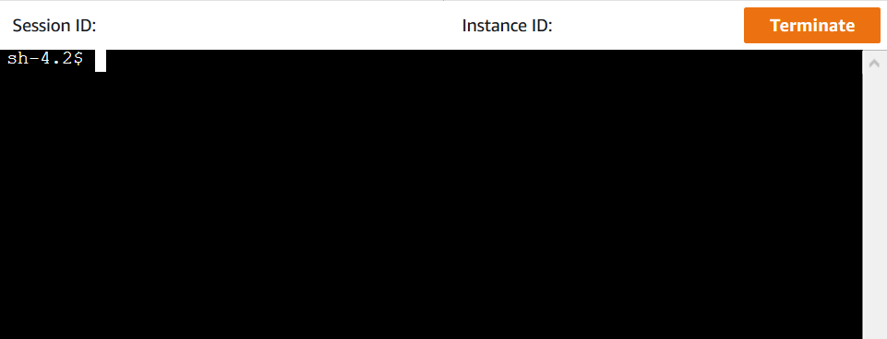
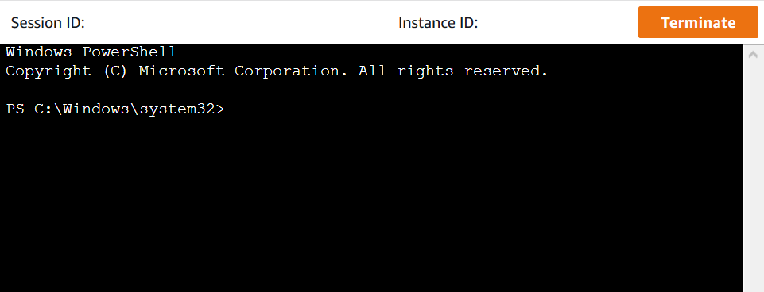
Session Manager core benefits
Single-step access to instances from the console or AWS CLI
Port forwarding
Cross-platform support for Windows, Linux, and macOS
Notes:
|Instructor notes
|Student notes
Single-step access to instances from the console and AWS CLI
Using the Systems Manager console or Amazon EC2 console, you can start a session with a single step. Using the AWS CLI, you can also start a session that runs a single command or a sequence of commands. Because permissions to instances are provided through IAM policies instead of SSH keys or other mechanisms, the connection time is greatly reduced.
Port forwarding
Redirect any port inside your remote instance to a local port on a client. After that, connect to the local port and access the server application that is running inside the instance. Use cases include scenarios such as communicating with web servers and database servers hosted in private subnets. You can also manage a Windows-based instance with Remote Desktop Protocol (RDP) enabled by using Session Manager. Session Manager tunnels traffic from the instance without the requirement of a gateway server.
Cross-platform support for both Windows and Linux
Session Manager provides support for Windows, Linux, and macOS from a single tool. For example, you don't need to use an SSH client for Linux and macOS instances or an RDP connection for Windows Server instances.

Slide 13



AWS CloudShell
AWS CloudShell
Provides command line access to AWS resources and tools directly from a browser
Development tools
CLIs, SDKs, and other tools
Storage
Up to 1 GB within the home directory
Notes:
|Instructor notes
|Student notes
AWS CloudShell is a browser-based shell that you can use to securely manage, explore, and interact with your AWS resources. CloudShell is preauthenticated with your console credentials.
Every CloudShell session creates a new shell that comes with common development and operations tools that are preinstalled, so no local installation or configuration is required. With CloudShell, you can quickly run scripts with the AWS CLI, experiment with AWS service APIs using the AWS SDKs, or use a range of other tools to be productive.
Store up to 1 GB of files within the home directory that can be shared across sessions initiated within the same Region. Shells are terminated when you close the session.

Slide 14
Tools for automating resource discovery
Notes:
|Instructor notes
|Student notes

Slide 15




AWS Systems Manager overview
AWS Systems Manager
Helps you safely manage and operate your resources at scale
Group resources
Visualize data
Take action
Notes:
|Instructor notes
|Student notes
With AWS Systems Manager, you can centralize operational data from multiple AWS services and automate tasks across your AWS resources. You can create logical groups of resources such as applications, different layers of an application stack, production environments, and development environments.
With Systems Manager, you can select a resource group and view the following details:
Recent API activity
Resource configuration changes
Related notifications
Operational alerts
Software inventory
Patch compliance status
You can also take action on each resource group, depending on your operational needs. Systems Manager provides a central place to view and manage your AWS resources, so you can have complete visibility and control over your operations.
Group resources
Group your AWS resources and save them into resource groups.
Visualize data
View aggregated operational data by resource group.
Take action
Respond to insights and automate operational actions across resource groups.

Slide 16





AWS Config overview
AWS Config
Records and normalizes the changes into a consistent format
Discover resources
Record configurations
Capture changes
Analyze changes
and remediate
Notes:
|Instructor notes
|Student notes
AWS Config is a fully managed service that provides you with the following to facilitate security and governance:
AWS resource inventory
Configuration history
Configuration change notifications
With AWS Config, you can perform the following activities:
Discover resources – Discover resources that exist in your account for a complete AWS resource inventory.
Record configurations – Record current resource configurations.
Capture changes – Capture any changes to the configurations and save for historical data.
Analyze changes and remediate – Determine whether changes require action based on AWS Config rules and settings. Rules and settings can include remediation and notifications.
These capabilities support compliance auditing, security analysis, resource change tracking, and troubleshooting.

Slide 17
AWS Config: Use cases
Change management
Compliance
Mapping of resource relationships (dependencies)
Configuration history
Information to assess the impact of a change
Multi-account, multi-Region aggregated data
Compliance status of resource
Centralized console to manage resources
AWS Config
Notes:
|Instructor notes
|Student notes
Change management
Use AWS Config to track the relationships between resources and review resource dependencies before making changes. After you make a change, you can quickly review the history of the resource's configuration and determine what the resource’s configuration settings were any point in the past.
AWS Config provides you with information to assess how a change to a resource configuration would affect your other resources. With this knowledge, you can minimize the impact of change-related incidents.
Enterprise-wide compliance monitoring
AWS Config provides multi-account, multi-Region data aggregation. You can view compliance status across your enterprise and identify noncompliant accounts. You can examine more closely the status for a specific AWS Region or a specific account across Regions. You can view this data from the AWS Config console in a central account. This removes the need to retrieve this information individually from each account.

Slide 18



AWS Config rules
Managed rules
Defined and maintained by AWS
Require minimal to no configuration
Custom rules
Defined and maintained by customers
Use AWS Lambda functions
AWS Config
Administrator
Notes:
|Instructor notes
|Student notes
Using AWS Config rules, you can run continuous assessment checks on your resources to verify that they comply with your own security policies, industry best practices, and compliance standards. AWS provides several managed, prebuilt rules that require minimal to no configuration. For example, AWS Config provides a rule to ensure that encryption is turned on for all Amazon Elastic Block Store (Amazon EBS) volumes in your account.
Prebuilt, managed rules
Managed rule examples:
Is multi-factor authentication (MFA) enabled for IAM console access?
Are access keys rotated?
Are all attached Amazon EBS volumes encrypted?
Do all Amazon EC2 instances belong to a VPC?
Are all resources tagged as expected?
Do all security groups in use deny unregulated, incoming SSH traffic?
Is AWS CloudTrail enabled in your AWS account?
Does the password policy for IAM users meet specified requirements?
Custom rules
You can also write a custom AWS Config rule to code your own corporate security policies. Custom rules are associated with an AWS Lambda function that you create and maintain. When you invoke a custom rule, it runs the associated Lambda function. AWS Config alerts you in real time when a resource is misconfigured or when a resource violates a particular security policy.
For more information, see “AWS Config Managed Rules” in the AWS Config Developer Guide (http://docs.aws.amazon.com/config/latest/developerguide/evaluate-config_use-managed-rules.html).

Slide 19
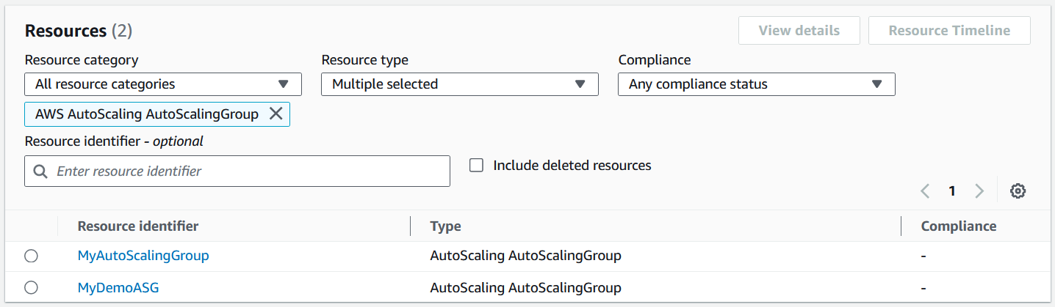
Setting up AWS Config
1. Specify settings.
2. Select rules.
Resource types
S3 bucket
Amazon SNS
IAM role
Managed rules
Custom rules
3
AWS Config starts recording resources.
4
View or search resources.
Notes:
|Instructor notes
|Student notes
Setting up AWS Config from the console
Enabling AWS Config requires you to specify the following settings in the console:
Resource types that you want the service to record
Whether to create or use an existing Amazon S3 bucket to receive configuration information
Whether to enable Amazon SNS to notify you of configuration changes
Whether to create an IAM role or use an existing one
Determine which AWS Config rules you want to select for your setup.
During the setup process, you can select only AWS Config managed rules.
After setup, you can create your own custom AWS Config rules.
After setup, AWS Config begins to discover your resources and records any changes to your account.
View your AWS resource inventory or configuration details in the AWS Config dashboard.
For more information, see the following in the AWS Config Developer Guide:
“Setting Up AWS Config with the Console” (https://docs.aws.amazon.com/config/latest/developerguide/gs-console.html)

Slide 20
Inventory with AWS Systems Manager and AWS Config
Notes:
|Instructor notes
|Student notes

Slide 21






AWS Config compared to Inventory
AWS Cloud
S3 buckets
S3 buckets
Users
VPC
AWS Config
Private subnet
Public subnet
EC2 instance contents
OS
Software
Patches
Windows Registry
Instance details
EBS volumes
Amazon RDS instances
Amazon RDS instances
EC2 instances
AWS Systems Manager
Systems Manager is agent based.
Notes:
|Instructor notes
|Student notes
For visibility into your AWS resources, you have two options: AWS Config or Inventory, a capability of AWS Systems Manager. Or you can use both. As mentioned, AWS Config is a fully managed service that provides you with an AWS resource inventory and configuration history. By contrast, AWS Systems Manager Inventory collects information about your instances and the software installed on them. This information helps you to understand your system configurations and installed applications. You can collect data about the following system properties:
Applications
Files
Network configurations
Windows services
Registries
Server roles
Updates
With the gathered data, you can manage application assets, track licenses, monitor file integrity, discover applications not installed by a traditional installer, and more.

Slide 22
AWS Config integrates with Inventory
AWS Cloud
S3 buckets
S3 buckets
Users
VPC
AWS Config
Private subnet
Public subnet
EC2 instance contents
OS
Software
Patches
Windows Registry
Instance details
EBS volumes
Amazon RDS instances
Amazon RDS instances
EC2 instances
AWS Systems Manager
Notes:
|Instructor notes
|Student notes
AWS Config is designed to integrate with AWS Systems Manager and its capabilities. This integration makes it possible for AWS Config to record software configuration changes within your EC2 instances and servers running on premises. You can combine the ability of Systems Manager to inventory operating system (OS) configurations, system-level updates, and installed applications with the ability of AWS Config to record historical data.

Slide 23



Multi-account inventory
Management account/root
2
Multi-account inventory data is in one dashboard.
Organizational unit
Account
1
Account inventory and configuration are aggregated.
AWS Config
Notes:
|Instructor notes
|Student notes
If you need to inventory resources from multiple AWS accounts, use AWS Config to aggregate your inventory to a centralized location.

Slide 24
Example Corp. manager requests
AWS account resources must be inventoried.
What are best practices for tracking inventory of your AWS accounts?
Which tools would you use to gain visibility into your AWS resources?
How can you track inventory from multiple AWS accounts?
How have you tracked inventory in the past?
Notes:
|Instructor notes
|Student notes

Slide 25
Troubleshooting scenario
Notes:
|Instructor notes
|Student notes

Slide 26

Troubleshooting issue
You do not have permissions to assign a new SSMmanagedInstanceRole to your EC2 instance.
Your current permissions:
{
"Sid": "EC2",
"Effect": "Allow",
"Action": "ec2:*",
"Resource": "*"
},
{
"Sid": "Passrole",
"Effect": "Allow",
"Action": "iam:PassRole",
"Resource": "arn:aws:iam:::role/EC2*"
}
Notes:
|Instructor notes (x min for this module)
|Student notes
You have been asked to set up your EC2 instances to work with Systems Manager. To do this, you must assign a role so that your instances can interact with Systems Manager.
You created a new role with the appropriate permissions in your account named SSMmanagedInstanceRole. However, when you try to assign it to the instances, you are denied access. You discover that you have the permissions statement presented on the slide in your own role.

Slide 27
Troubleshooting solution
The Resource for iam:PassRole grants permission to pass roles that begin only with EC2*.
{
"Sid": "EC2",
"Effect": "Allow",
"Action": "ec2:*",
"Resource": "*"
},
{
"Sid": "Passrole",
"Effect": "Allow",
"Action": "iam:PassRole",
"Resource": "arn:aws:iam:::role/EC2*"
}
Notes:
|Instructor notes (x min for this module)
|Student notes

Slide 28
Summary
In this module, we discussed the following:
Using AWS CLI to interact with AWS resources
The benefits of using Session Manager
Automating resource discovery with AWS Config and AWS Systems Manager
Notes:
|Instructor notes (x min for this module)
|Student notes

Slide 29
Lab 1
Auditing AWS Resources with AWS Systems Manager and AWS Config
Duration: 45 minutes
Notes:
|Instructor notes
|Student notes

Slide 30




Diagram: Auditing AWS Resources with AWS Systems Manager and AWS Config
1
AWS Cloud
VPC
Set up AWS Systems Manager.
Public subnet
IAM users
AWS Systems Manager
2
WebServer
AppServer
5
Access WebServer.
Session Manager
Inventory
Explore inventory.
3
ec2-instance-managed-by-systems-manager
iam-user-no-policies-check
4
AWS Config
Set up AWS Config.
Audit compliance.
Notes:
|Instructor notes
|Student notes
This lab will take you through the following procedures:
Setting up AWS Systems Manager
Using Session Manager to connect to an EC2 instance
Setting up AWS Config
Using AWS Config to audit IAM user permissions
Exploring inventory collected by Systems Manager

Slide 31
Thank you
Corrections, feedback, or other questions? Contact us at https://support.aws.amazon.com/#/contacts/aws-training. All trademarks are the property of their owners.
Notes:
|Instructor notes
|Student notes

