Slide 1


Cloud Operations on AWS
Module 6:
Manage Resources
Lab 3
Notes:
|Instructor notes
|Student Notes

Slide 2
Module overview
Course scenario
AWS Systems Manager
Operations tools
Application tools
Change management tools
Node tools
Troubleshooting
Lab 3: Operations as code
Notes:
|Instructor Notes
|Student Notes

Slide 3
Example Corp. manager requests
Streamline processes.
Minimize customer impact of system updates.
Track activity in your environment.
Notes:
|Instructor Notes
|Student Notes
Example Corp. has launched a new application, and leadership wants your team to manage its resources and workloads. Your manager has asked you to develop a plan to streamline processes, reduce downtime, and track activity in your environment.

Slide 4
Deployment compared to management
Deployment
Deploy repeatable and identical environments.
Abide by company standards.
Configure for traceability.
Employ a self-service model.
Management
Gain operational insight.
Organize resources.
Secure confidential data.
Update resources.
Automate operations.
Notes:
|Instructor Notes
|Student Notes
Although the cloud can offer many capabilities, you must consider how to manage its power and flexibility with the following questions:
How do you update servers that have already been deployed into a production environment?
How do you track and manage incidents in your environment?
How do you organize your resources?
How do you securely and efficiently store passwords and other confidential data?
How do you control administrative access to your instances?
How do you automate more administrative tasks?

Slide 5
AWS Systems Manager
Notes:
|Instructor Notes
|Student Notes

Slide 6





AWS Systems Manager overview
Operations tools
Hybrid
AWS Cloud
Application tools
Instances
Instances
Change management tools
Corporate data center
AWS Systems Manager
Node tools
Server
Server
Notes:
|Instructor Notes
|Student Notes
AWS Systems Manager is a management service that helps you to do the following:
Centralize operational data.
Collect software inventory.
Apply operating system (OS) patches.
Create system images.
Configure Windows and Linux operating systems.
Systems Manager is designed to automate configuration and management of systems running on premises or in AWS. Systems Manager is where you can select the instances you want to manage and define the related management tasks.

Slide 7




Systems Manager prerequisites
3
AWS Cloud
VPC
Create instance profile roles for Amazon EC2 instances and service roles for external systems
Instances
Instances
Corporate data center
1
Systems Manager
VPC endpoint
Server
Server
IAM user has permission to use the service
4
2
5
Allow HTTPS outbound traffic
Install AWS Systems Manager Agent (SSM Agent)
(Optional)
Create VPC endpoint
Notes:
|Instructor Notes
|Student Notes
You might recall setting up Systems Manager in Lab 1: Auditing AWS resources with AWS Systems Manager and AWS Config.
You must complete the following prerequisites before using Systems Manager to manage your Amazon Elastic Compute Cloud (Amazon EC2) instances, on-premises servers, and virtual machines (VMs):
Ensure that the AWS Identity and Access Management (IAM) user has permissions to use Systems Manager.
Install or verify the installation of AWS Systems Manager Agent (SSM Agent) on each of your managed instances.
Do one or more of the following:
For Amazon EC2 instances, create an IAM instance profile and attach it to your servers.
For on-premises servers, create an IAM service role for the hybrid environment.
Verify that you are allowing HTTPS (port 443) outbound traffic to the Systems Manager endpoints. This allows the SSM Agent to establish communication with Systems Manager.
(Optional) Create a virtual private cloud (VPC) endpoint in Amazon Virtual Private Cloud (Amazon VPC) to use with Systems Manager.
For more information, review the following in the AWS Systems Manager User Guide:
“Setting up AWS Systems Manager” (https://docs.aws.amazon.com/systems-manager/latest/userguide/systems-manager-prereqs.html)
“Create an IAM Service Role for a Hybrid Environment” (https://docs.aws.amazon.com/systems-manager/latest/userguide/sysman-service-role.html)
“Create VPC Endpoints” (https://docs.aws.amazon.com/systems-manager/latest/userguide/setup-create-vpc.html)

Slide 8
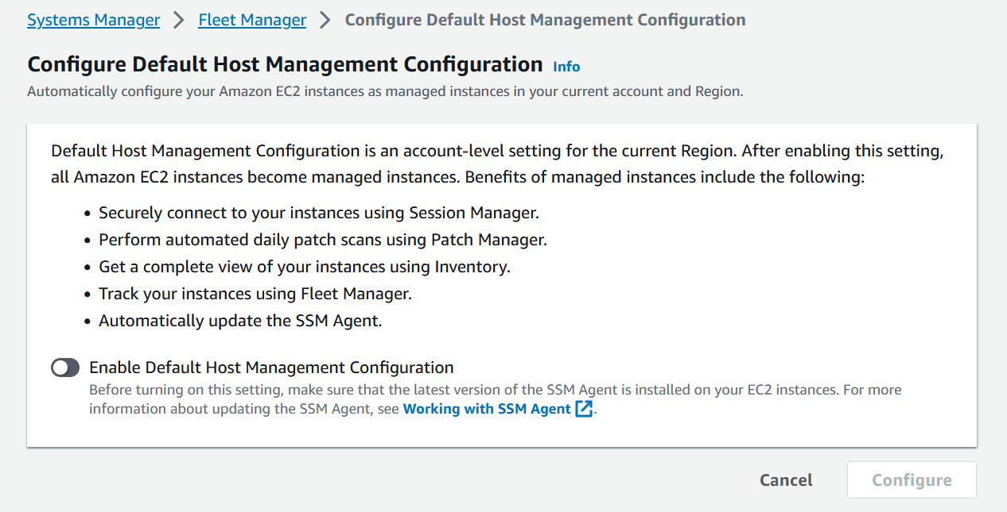
Enabling Systems Manager at the account level
Enable
Notes:
|Instructor Notes
|Student Notes
AWS Systems Manager customers now have the option to enable Systems Manager and configure permissions for all EC2 instances in an account, with a single action by using Default Host Management Configuration (DHMC). This feature provides a method to help ensure Patch Manager, Session Manager, and Inventory, all capabilities of AWS Systems Manager, are available for all new and existing instances in an account. DHMC is ideal for all Amazon EC2 users, and offers a simple, scalable process to standardize the availability of Systems Manager tools for users who manage many instances.
For more information, see “Default Host Management Configuration” in the AWS Systems Manager User Guide at: https://docs.aws.amazon.com/systems-manager/latest/userguide/managed-instances-default-host-management.html.

Slide 9
Operations tools
Notes:
|Instructor Notes
|Student Notes

Slide 10
Operations tools for administrators
Administrators need to have the following:
Visibility into operations data (OpsData)
The ability to investigate and remediate problems
Systems Manager capabilities:
Explorer
OpsCenter
Notes:
|Instructor Notes
|Student Notes

Slide 11
Explorer
A customizable dashboard with OpsData
EC2 instance metadata
Number of instances
Types of Amazon Machine Image (AMI) used
OpsCenter details
Various counts of operational work items (OpsItems)
OpsItems historical data
Patch compliance
Count of noncompliant instances
Other OpsData
AWS Trusted Advisor data
AWS Compute Optimizer data
Other operational data
View the status of AWS resources in multiple accounts and multiple Regions.
Notes:
|Instructor Notes
|Student Notes
Explorer, a capability of AWS Systems Manager, is a customizable operations dashboard. Explorer includes drag-and-drop widgets that automatically display actionable information about your AWS resources. Explorer displays an aggregated view of OpsData for your AWS accounts and across Regions. In Explorer, OpsData includes the following:
Metadata about your EC2 instances
Patch compliance details
OpsCenter details, such as operational work items (OpsItems)
Explorer provides context about the following:
How OpsItems are distributed across your business units or applications
How they trend over time
How they vary by category
You can group and filter information in Explorer to focus on items that are relevant to you and that require action. When you identify high-priority issues, you can use OpsCenter, a capability of Systems Manager, to run Automation (another capability of Systems Manager) documents (runbooks) to resolve issues quickly.
For more information about Explorer, see “AWS Systems Manager Explorer” in the AWS Systems Manager User Guide (https://docs.aws.amazon.com/systems-manager/latest/userguide/Explorer.html).

Slide 12
OpsCenter
Investigate and resolve OpsItems.
OpsItems
View OpsItem details.
Create, edit, and resolve OpsItems.
Search, filter, and examine similar OpsItems.
Runbooks
Remediate with runbooks.
Automate remediation.
Resource description
View resource configuration data.
Related resource details
Amazon CloudWatch alarms
AWS Config details
AWS CloudTrail logs
Notes:
|Instructor Notes
|Student Notes
OpsCenter provides a central location where operations engineers and IT professionals can view, investigate, and resolve OpsItems related to AWS resources. OpsCenter is designed to reduce mean time to resolution for issues affecting AWS resources. This Systems Manager capability aggregates and standardizes OpsItems across services while providing contextual investigation data about each OpsItem, related OpsItems, and related resources. OpsCenter also provides Automation documents (runbooks) that you can use to resolve issues quickly.
For more information, see “AWS Systems Manager OpsCenter” in the AWS Systems Manager User Guide (https://docs.aws.amazon.com/systems-manager/latest/userguide/OpsCenter.html).

Slide 13
Creating OpsItems
Amazon CloudWatch alarms
OpsItems
Security issues
Performance issues
Failures
Health alerts
State changes
Amazon EventBridge events
Amazon CloudWatch Application
Insights for .NET and SQL Server
Manual creation
Notes:
|Instructor Notes
|Student Notes
Systems Manager automatically creates OpsItems in OpsCenter for some AWS services and Systems Manager capabilities, if those services and capabilities are enabled. You can also configure the system to create OpsItems automatically based on Amazon CloudWatch alarms and Amazon EventBridge events. When an alarm reaches the alarm state or an event is processed, the system creates an OpsItem in OpsCenter and provides detailed information about the alarm or the event in the OpsItem. You can also create OpsItems manually.
For example, you can configure OpsItems as the target for the following types of events, and hundreds more:
Security issues, such as alerts from AWS Security Hub
Performance issues, such as a throttling event for Amazon DynamoDB or degraded Amazon Elastic Block Store (Amazon EBS) volume performance
Failures, such as an Amazon EC2 Auto Scaling group failure to launch an instance or an Automation failure
Health alerts, such as an AWS Health alert for scheduled maintenance
State changes, such as an EC2 instance state change from Running to Stopped
OpsCenter is integrated with Amazon CloudWatch Application Insights for .NET and SQL Server. CloudWatch Application Insights helps you monitor your applications that use Amazon EC2 instances along with other application resources. When you configure application resources in CloudWatch Application Insights, you can choose to have the system create OpsItems in OpsCenter when problems are detected. You can specify searchable, custom data for each OpsItem. You can also view automatically generated summary reports about OpsItems by status and source.
For more information, see “AWS Systems Manager OpsCenter” in the AWS Systems Manager User Guide (https://docs.aws.amazon.com/systems-manager/latest/userguide/OpsCenter.html).

Slide 14
Application tools
Notes:
|Instructor Notes
|Student Notes

Slide 15
Application tools for administrators
Administrators need to do the following:
Organize resources.
Create, manage, and deploy application configurations.
Securely store configuration and secrets data.
Systems Manager capabilities:
Application Manager
AWS AppConfig
Parameter Store
Notes:
|Instructor Notes
|Student Notes

Slide 16
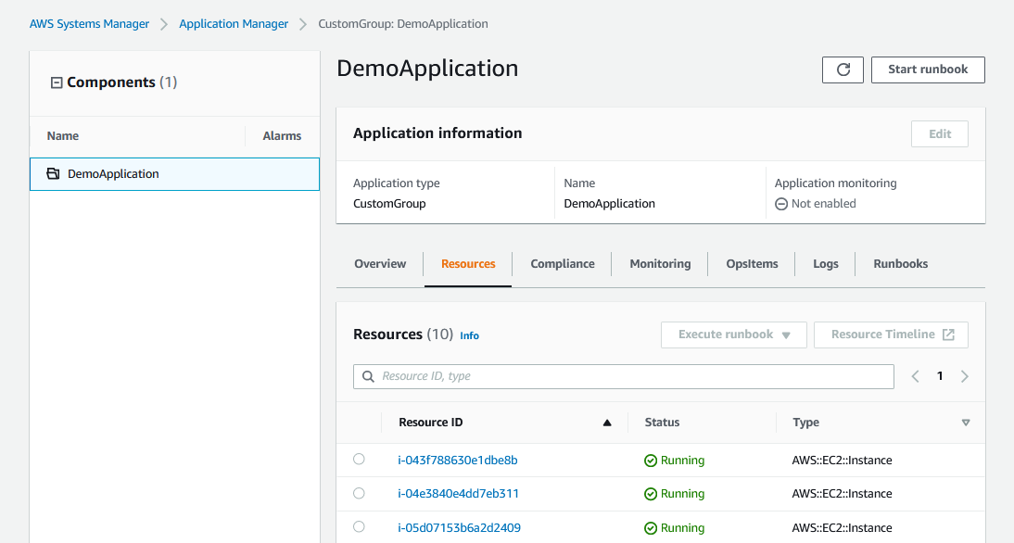
Application Manager
Use Application Manager console to do the following:
Discover applications.
View aggregated operational data.
Perform actions.
Notes:
|Instructor Notes
|Student Notes
Application Manager, a capability of AWS Systems Manager, is designed to manage applications from a single console. Developers and operators can use the new capability to discover their applications, view operational data, and perform actions within the context of an application.
With Application Manager, customers can discover applications across multiple AWS services, such as AWS CloudFormation stacks, AWS Resource Groups, Amazon Elastic Kubernetes Service (Amazon EKS) clusters, and AWS Launch Wizard. After discovery, users can view operational and compliance data aggregated from services such as CloudWatch, AWS Config, AWS CloudTrail, and OpsCenter in a single dashboard. This can include such data as alarms, operational issues, and logs for their application. Application Manager includes predefined Automation runbooks for remediating common issues with AWS resources. Customers can choose a resource in Application Manager and then choose a runbook that performs a diagnostic or remediation task.
For more information about Application Manager, see “AWS Systems Manager Application Manager” in the AWS Systems Manager User Guide (https://docs.aws.amazon.com/systems-manager/latest/userguide/application-manager.html).

Slide 17




AWS AppConfig workflow
Use AWS AppConfig to create, manage, and quickly deploy application configurations.
1
2
3
4
Create an application.
Create an environment.
Create
configuration profiles and feature flags.
Choose a deployment strategy.
Notes:
|Instructor Notes
|Student Notes
Create an AWS AppConfig application.
An application in AWS AppConfig is a logical unit of code that provides capabilities for your users. For example, an application can be any of the following:
A microservice that runs on EC2 instances
A serverless application using Amazon API Gateway and AWS Lambda
Any system you run on behalf of others
Create an environment.
For each application, define one or more environments. An environment is a logical deployment group of AWS AppConfig applications, such as applications in a beta or production environment.
Create configuration profiles and feature flags.
A configuration is a collection of settings that influence the behavior of your application. Using a configuration profile, AWS AppConfig can access your configuration from a source location. You can store configurations in the following formats and locations:
YAML, JavaScript Object Notation (JSON), or text documents in the AWS AppConfig hosted configuration store
Objects in an Amazon Simple Storage Service (Amazon S3) bucket
Documents in the Systems Manager document store
Parameters in Parameter Store, a capability of AWS Systems Manager
A configuration profile can also include optional validators to make sure that your configuration data is syntactically and semantically correct.
Choose a deployment strategy.
A deployment strategy is an AWS AppConfig resource that helps you control deployments. You can deploy changes in seconds, or you can roll them out slowly to assess the impact of the changes. A deployment strategy includes the following information:
Total amount of time for a deployment to last
Percentage of targets to receive a deployed configuration during each interval
Amount of time that AWS AppConfig monitors for alarms before considering the deployment completed and ineligible for automatic rollback
For more information, see “What Is AWS AppConfig” in the AWS Systems Manager User Guide at https://docs.aws.amazon.com/systems-manager/latest/userguide/appconfig-working.html.

Slide 18
Parameter Store benefits
Parameter Store addresses many challenges of configuration data management and secrets management.
Challenges | Parameter Store benefits
Credentials in code | Data separated from code
Unencrypted | Encrypted
Tracking versions | Versioning
Changes made in many different locations | Centralized
Notes:
|Instructor Notes
|Student Notes
Parameter Store, a capability of AWS Systems Manager, provides secure, hierarchical storage for configuration data management and secrets management. You can store data such as the following:
Passwords
Database strings
AMI IDs
License codes
You can store values as plaintext or encrypted data.

Slide 19






Storing data with Parameter Store
Systems Manager
AWS Key Management Service (AWS KMS)
Parameter
name
Parameter
value
Parameter
value
TLS
AWS KMS key
Parameter Store
Parameter
name
Parameter
value
Parameter
value
Applications
Notes:
|Instructor Notes
|Student Notes
Instead of storing configuration data in configuration files or including it in your source code, use Parameter Store. By using Parameter Store, you can reference this information in your applications or scripts. Use Parameter Store to store configuration information such as passwords, keys, license codes, and database strings. This type of information is referenced in scripts and commands without having to enter it in plaintext.
In the example, a new parameter was created for a password.
When you create a secure string parameter, Parameter Store sends an encrypted request to AWS Key Management Service (AWS KMS). During transmission to AWS KMS, the plaintext value in the secure string parameter is protected by Transport Layer Security (TLS).
AWS KMS encrypts the parameter value with the specified AWS KMS key and encryption context. It returns the ciphertext to Parameter Store, which stores the parameter name and its encrypted value.
Parameter Store integrates with IAM to control parameter access. It also integrates with AWS KMS to encrypt stored information.
For more information, see “How AWS Systems Manager Parameter Store uses AWS KMS” in the AWS KMS Developer Guide (https://docs.aws.amazon.com/kms/latest/developerguide/services-parameter-store.html).

Slide 20
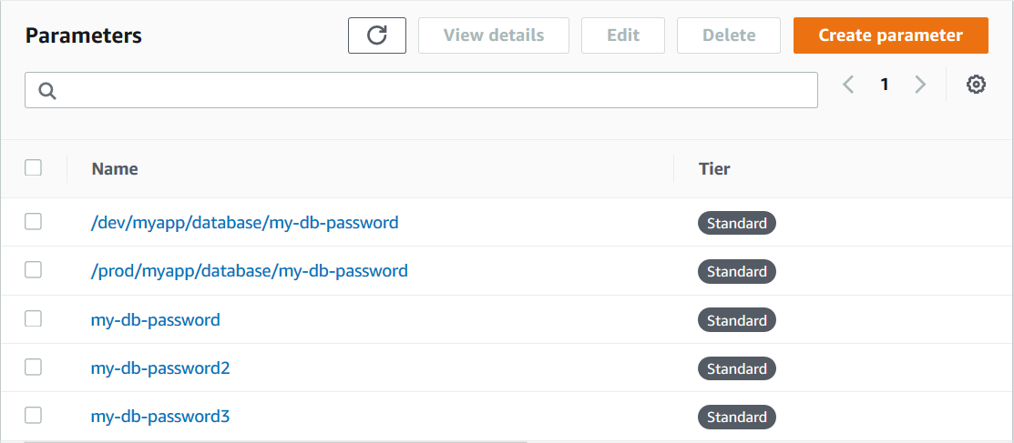
Organizing parameters into hierarchies
A hierarchy is a parameter name that includes a path defined by forward slashes.
/myapp/production/ami-id
/myapp/development/ami-id
Not an actual directory structure
/myapp/production/log-level
/myapp/development/log-level
/myapp/staging/ami-id
Examples of parameters with three hierarchy levels
Notes:
|Instructor Notes
|Student Notes
Managing dozens or hundreds of parameters as a flat list is time consuming and prone to errors. It can also be difficult to identify the correct parameter for a task. This means that you might accidentally use the wrong parameter or you might create multiple parameters that use the same configuration data.
You can use parameter hierarchies to help you organize and manage parameters. A hierarchy is a parameter name that includes a path that you define by using forward slashes (/). For example, you might organize application configuration data like this:
/myapp/production/ami-id
/myapp/development/ami-id
/myapp/production/log-level
/myapp/development/log-level
/myapp/staging/log-level
This structure groups related parameters by environment, makes it easy to identify the correct parameter for a task, and helps you manage access at different hierarchy levels using AWS Identity and Access Management (IAM) policies.
A parameter label is a user-defined alias to help you manage different versions of a parameter. When you modify a parameter, Systems Manager automatically saves a new version and increments the version number by one. A label can help you remember the purpose of a parameter version when there are multiple versions.
Note: Parameter Store is designed for configuration data such as AMI IDs, instance types, environment names, and feature flags. For secrets such as database passwords, API keys, and OAuth tokens, use AWS Secrets Manager, which provides additional capabilities including automatic rotation, cross-account sharing, and native integrations with Amazon RDS and Amazon Aurora.
For more information about parameter labels, see “Working with Parameter Hierarchies” in the AWS Systems Manager User Guide (https://docs.aws.amazon.com/systems-manager/latest/userguide/sysman-paramstore-hierarchies.html).

Slide 21
Public parameters in Parameter Store
Location of Amazon EC2 AMI public parameters:
/aws/service/ami-amazon-linux-latest
/aws/service/ami-windows-latest
AWS CLI
aws ssm get-parameters --names /aws/service/ami-windows-latest/Windows_Server-2016-English-Full-Base --region us-east-1
PowerShell
Get-SSMParameter -Name /aws/service/ami-windows-latest/Windows_Server-2016-English-Full-Base -region us-east-1
Notes:
|Instructor Notes
|Student Notes
Some AWS services publish information about common artifacts as Systems Manager public parameters. For example, Amazon EC2 publishes information about AMIs as public parameters. You can call this information from your scripts and code.
Public parameters can be accessed from the console, AWS Command Line Interface (AWS CLI), PowerShell, or an SDK.
For more information, see “Working with Public Parameters” in the AWS Systems Manager User Guide (https://docs.aws.amazon.com/systems-manager/latest/userguide/parameter-store-public-parameters.html).

Slide 22
Parameter Store calls in AWS CloudFormation templates
Retrieve publicly and privately stored values in Parameter Store through CloudFormation.
Parameters :
LatestAmiId :
Type : 'AWS::SSM::Parameter::Value<AWS::EC2::Image::Id>'
Default : '/aws/service/ami-amazon-linux-latest/amzn2-ami-hvm-x86_64-gp2'
Resources :
Instance :
Type : 'AWS::EC2::Instance'
Properties :
ImageId : !Ref LatestAmiId
Notes:
|Instructor Notes
|Student Notes
When using AWS CloudFormation templates to code your infrastructure, consider integrating Parameter Store to improve the maintainability of your code. With Parameter Store, you can set up parameter strings that you can store and update centrally. As a result, you can reuse the strings in template code and in many other use cases beyond CloudFormation.
Previously, you could specify values for these parameters in the following ways:
Pass the plaintext values as arguments to the CloudFormation API.
Hardcode the parameter values in the template using default values.

Slide 23
Change management tools
Notes:
|Instructor Notes
|Student Notes

Slide 24
Change management tools for administrators
Administrators need to do the following:
Update managed instances.
Minimize disruption.
Systems Manager capabilities:
Automation
Maintenance Windows
Notes:
|Instructor Notes
|Student Notes

Slide 25




Automation
Safely automate common and repetitive IT operations and management tasks across AWS resources.
Automation
1
2
3
Create an Automation document.
Run the Automation document.
Monitor and test Automation.
Notes:
|Instructor Notes
|Student Notes
You can use the Automation, a capability of Systems Manager, to build workflows and simplify common maintenance and deployment tasks. For instance, Automation can define the following:
How you want to create your AMIs
Software installed on your image
Amount of memory
Other resources
In general, the Automation workflow includes the following main steps:
Create an Automation document, or use a template, which includes sequential steps and parameters that Systems Manager runs.
Systems Manager runs the document, which defines how to launch the image, take a snapshot, tag instances, delete earlier images, and terminate the image.
Use the console to monitor the workflow. After it finishes, you can launch a test instance from the updated AMI to verify changes.
For an example, see “Run an Automation with Approvers” in the AWS Systems Manager User Guide (https://docs.aws.amazon.com/systems-manager/latest/userguide/automation-working-executing-approval.html).

Slide 26
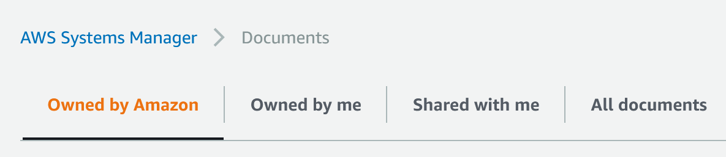
Document options
Owned by Amazon
Owned by me
Shared with me
Favorites
All documents
AWS provides over 75 predefined
AWS Systems Manager Automation documents.
Customize an existing Automation document
or create your own.
Use a shared document from another account.
Notes:
|Instructor Notes
|Student Notes
An AWS Systems Manager document defines the actions that Systems Manager performs on your managed instances. Systems Manager includes more than a dozen preconfigured documents that you can use by specifying parameters at runtime. Documents use JSON or YAML format, and they include steps and parameters that you specify. You can use a predefined Systems Manager Automation document, create your own custom document, or use a shared document.
For more information, see “AWS Systems Manager Documents” in the AWS Systems Manager User Guide (https://docs.aws.amazon.com/systems-manager/latest/userguide/sysman-ssm-docs.html).

Slide 27
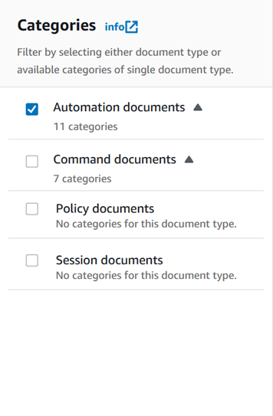
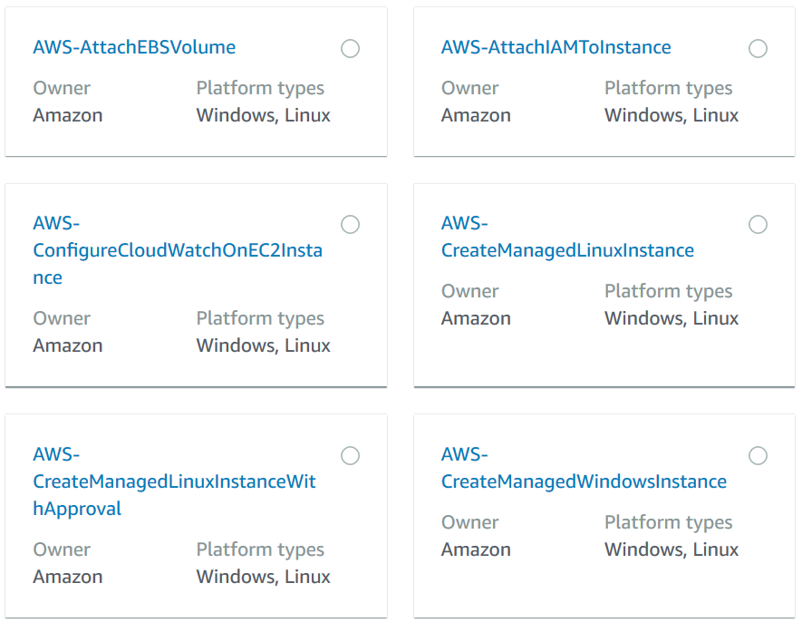
Predefined Automation documents
Filter documents by categories.
Select the Automation document you want to run.
Notes:
|Instructor Notes
|Student Notes
Systems Manager provides more than 70 predefined Automation documents that you can use or customize to manage your resources. You can filter your documents by categories.

Slide 28
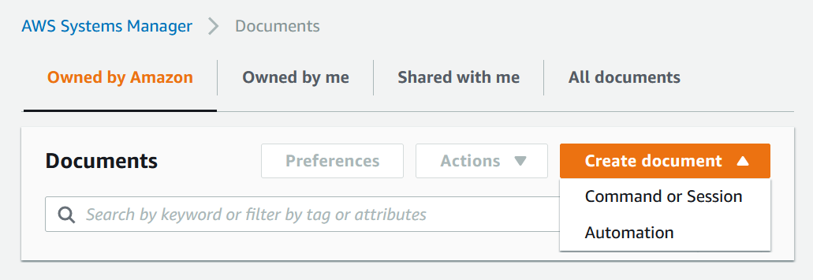
Creating custom documents
Owned by Amazon
Owned by me
Shared with me
Favorites
All documents
Command document
Automation document
Run commands on managed instances.
Invoke AWS Services
Create workflows
Scripting & Conditional automation
Run across multiple AWS accounts and Regions
Notes:
|Instructor Notes
|Student Notes
If the Systems Manager public documents don't perform all the actions that you want to perform on your AWS resources, you can create your own Systems Manager documents. You can create two primary types of documents:
Command documents
Automation documents
Command documents are used to run scripts on a set of instances. They are used with Run Command, State Manager, and Maintenance Windows.
Automation documents are used to create a workflow that follows a sequential order. They are used with Automation, State Manager, and Maintenance Windows.

Slide 29
Command documents
schemaVersion: '2.2’
description: install using aws:applications
mainSteps:
action: aws:applications
name: installMsi
inputs:
action:
Install source: "{{ url for .msi }}"
Command document using aws:applications for Windows
schemaVersion: '2.2'
description: install using aws:runShellScript
mainSteps:
action: aws:runShellScript
name: installApache
inputs:
runCommand:
'sudo yum update –y'
'sudo yum install -y httpd'
'sudo systemctl start httpd.service'
Command document using aws:runShellScript for Linux
Notes:
|Instructor Notes
|Student Notes
When you create a new command document, we recommend that you use Schema version 2.2 or later so that you can take advantage of the latest features. These features include document editing, automatic versioning, sequencing, and more.
The following top-level elements provide the structure of the Systems Manager document:
schemaVersion – The schema version to use
Type: Version
Required: Yes
description – Information that you provide to describe the purpose of the document
Type: String
Required: No
mainSteps – (Schema version 0.3, 2.0, and 2.2 only) An object that can include multiple steps (plugins). Plugins are defined in steps. Steps run in sequential order, as listed in the document.
Type: Dictionary<string,PluginConfiguration>
Required: Yes
AWS Systems Manager categorizes command documents owned by AWS to improve discoverability.

Slide 30
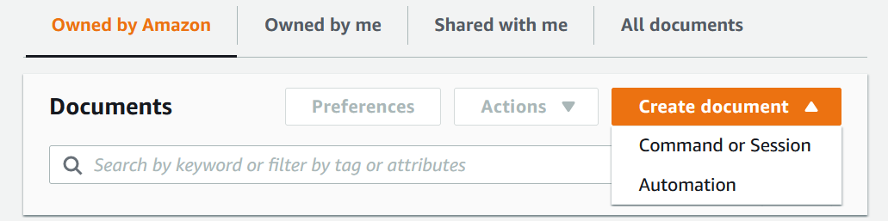


Creating Automation documents
Owned by Amazon
Owned by me
Shared with me
Favorites
All documents
Visual design experience
Code editor
Notes:
|Instructor Notes
|Student Notes
An Automation document defines the Automation workflow (the actions that Systems Manager performs on your managed instances and AWS resources). An Automation document contains one or more steps that run in sequential order. Each step is built around a single action. More than 20 different actions are available.
When you create a new Automation document, AWS Systems Manager provides two authoring experiences to match different skill levels and use cases.
The visual design experience is a low-code, drag-and-drop canvas for building Automation workflows. You access it directly from the Automation console when you choose to create or edit a runbook. The interface has three main panels. The Actions browser on the left contains tabs for available actions, AWS API calls, and reusable runbooks organized by category. The canvas in the center is where you drag actions from the browser to build your workflow. You can connect steps, add conditional branches based on step outcomes, and configure error handling. As you work, the system validates your workflow and auto-generates the underlying YAML or JSON code in real time. The Form panel on the right lets you configure properties for each step, including inputs, outputs, timeouts, and error behavior, using a guided form interface. When you are finished, you can save your runbook, run it, and examine the results in the Automation console. You can also export the generated code for local development using the AWS Toolkit for Visual Studio Code.
If you are comfortable writing JSON or YAML directly, use the code editor to author the document yourself. The visual design experience includes a code pane alongside the visual workflow pane, so you can switch between the two views at any time. This gives you full control over every aspect of the document syntax and is the right choice if you are working with infrastructure as code tools or modifying an existing document.

Slide 31
Automation document components
Automation document
Document attributes:
Roles
Input parameter
Target type
Tags
Action types (20+):
Run a script
aws:executeScript
Create an AMI
aws:createImage
Create a stack
aws:createStack
Run AWS API actions
aws:executeAwsApi
Others
Steps:
Sequential order
Action type
Notes:
|Instructor Notes
|Student Notes
An Automation document is composed of two primary sections: the document attributes and steps. Automation documents contain one or more steps that run in sequential order. Each step is built around a single action. More than 20 actions are available.
Here are some examples of these actions:
ExecuteScript – Run Python or PowerShell script directly.
CreateStack – Launch an AWS CloudFormation template.
ExecuteAWSapi – Run any AWS API call.
For more information, see “Systems Manager Automation Actions Reference” in the AWS Systems Manager User Guide (https://docs.aws.amazon.com/systems-manager/latest/userguide/automation-actions.html).

Slide 32





Maintenance Windows
Schedule windows of time to run administrative and maintenance tasks across your instances.
Maintenance Windows
1
2
3
4
Create a
maintenance window.
Assign targets.
Assign tasks.
Review status after task is completed.
Notes:
|Instructor Notes
|Student Notes
Use Maintenance Windows, a capability of AWS Systems Manager, to define a schedule for when to perform potentially disruptive actions on your instances. For example, these actions can include patching an OS, updating drivers, or installing software or patches. Using Maintenance Windows, you can schedule actions on numerous other AWS resource types, such as the following:
Amazon S3 buckets
Amazon Simple Queue Service (Amazon SQS) queues
AWS KMS keys
For more information, see “AWS Systems Manager Maintenance Windows” in the AWS Systems Manager User Guide (https://docs.aws.amazon.com/systems-manager/latest/userguide/systems-manager-maintenance.html).

Slide 33
Node tools
Notes:
|Instructor Notes
|Student Notes

Slide 34
Node tools for administrators
Administrators need to do the following:
Connect securely to instances.
Control access to instances.
Track user activity in instances.
Systems Manager capabilities:
Fleet Manager
Compliance
Inventory
Hybrid Activation
Session Manager
Run Command
State Manager
Patch Manager
Distributor
Notes:
|Instructor Notes
|Mention that Inventory and Session Manager were already covered in prior modules.
|Hybrid Activation and Distributor are not covered.
|Student Notes

Slide 35




Fleet Manager
Fleet Manager
Linux instance
Admin
Console
Streamline your remote server management process.
Common management tasks
Windows instance
View file system
Tail logs
Manage users and groups
Manage processes
View performance data
Manage Windows registry
Other
Mac instance
On-premises instance
Notes:
|Instructor Notes
|Student Notes
Fleet Manager, a capability of AWS Systems Manager, is a unified user interface (UI) experience that helps you remotely manage your nodes running on AWS or on premises. With Fleet Manager, you can view the health and performance status of your entire server fleet from one console. You can also gather data from individual nodes to perform common troubleshooting and management tasks from the console. This includes connecting to Windows instances using the Remote Desktop Protocol (RDP), viewing folder and file contents, managing the Windows registry, managing OS users, and more.

Slide 36
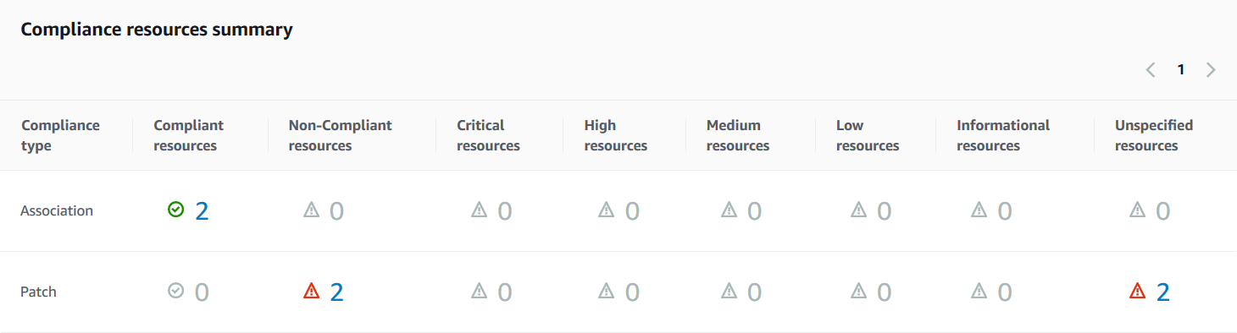
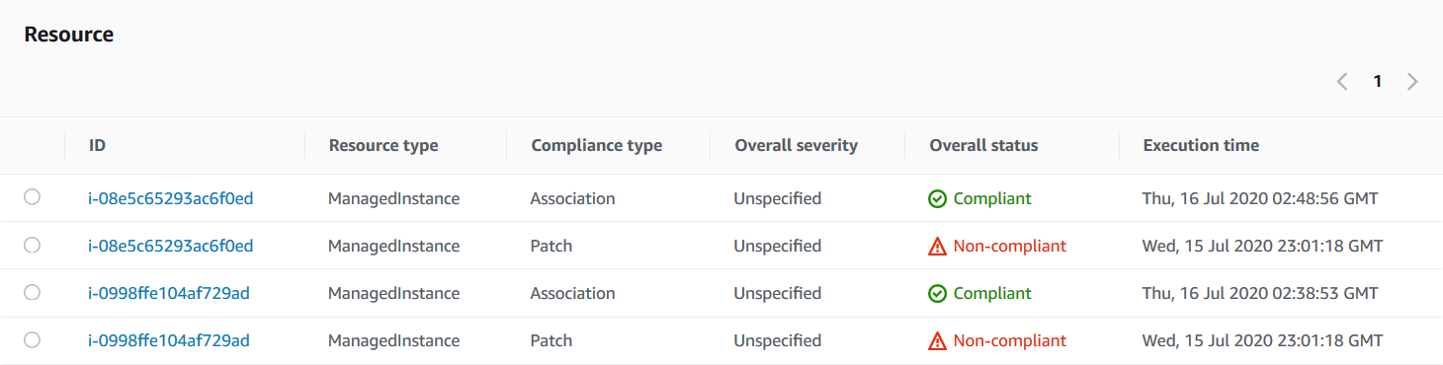
Compliance dashboard
Summary count of pass and fail
Helps you to identify
noncompliant resources
Notes:
|Instructor Notes
|Student Notes
You can use Compliance, a capability of AWS Systems Manager, to scan your fleet of managed instances for patch compliance and configuration inconsistencies. You can collect and aggregate data from multiple AWS accounts and Regions, and then drill down into specific resources that aren’t compliant. The Compliance resources summary section displays a count of resources that pass and fail compliance requirements. The Resource section helps you to identify noncompliant resources. You can drill down into more details about the resource’s compliance history.

Slide 37
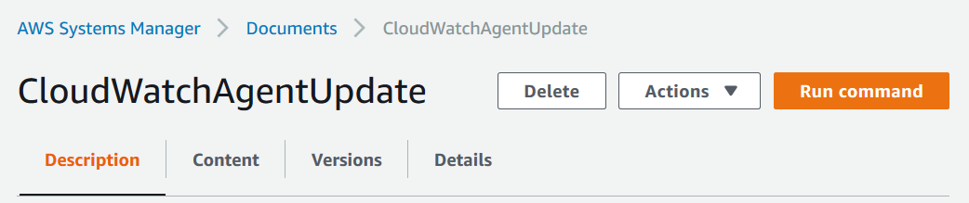
Command documents and Run command
Command parameters
Targets
Rate control
Output options
Sample command document named CloudWatchAgentUpdate
SNS notifications
Notes:
|Instructor Notes
|Student Notes
In this example, CloudWatchAgentUpdate is a command document in the Systems Manager console. You can run the command document by choosing Run command. You can set some of the following options before running the document:
In the Targets section, identify the instances on which you want to run this operation. Specify tags, choose instances manually, or specify a resource group.
(Optional) For Rate control, specify a number or a percentage of instances on which to run the command at the same time.
(Optional) For Output options, to save the command output to a file, select the Write command output to an S3 bucket check box. Enter the bucket and prefix (folder) names in the boxes.
In the SNS notifications section, if you want notifications sent about the status of the run command, select the Enable SNS notifications check box.

Slide 38



State Manager
Maintain a consistent configuration of your Amazon EC2 instances or on-premises instances.
State Manager
1
2
3
4
Choose or create an automation document.
Associate your instances with the document.
Specify a schedule for the state.
(Optional) Write output data to Amazon S3.
Notes:
|Instructor Notes
|Student Notes
State Manager, a capability of AWS Systems Manager, is a secure and scalable configuration management service that automates the process of keeping your Amazon EC2 and hybrid infrastructure in a specified state.
With State Manager, you can do the following:
Install software at instance creation.
Download and update agents.
Configure network settings.
Join a Windows domain.
Patch instances with software updates.
Run scripts on Linux-managed and Windows-managed instances.
Here’s how State Manager works:
Determine the state you want to apply to your managed instances and choose or create a Systems Manager document. The document defines the actions that Systems Manager performs on your managed instances. Systems Manager includes preconfigured documents that you can use by specifying parameters at runtime. Documents use JSON or YAML, and they include steps and parameters that you specify.
Associate your managed instances with the Systems Manager document.
When creating the association, define the schedule for how often to apply the configured state.
(Optional) Write the output of the commands to an Amazon S3 bucket when you create an association.
For more information, see “AWS Systems Manager State Manager” in the AWS Systems Manager User Guide (https://docs.aws.amazon.com/systems-manager/latest/userguide/systems-manager-state.html#systems-manager-state).

Slide 39




Patch Manager and patch policies
Deploy patches automatically across large groups of EC2 instances or on-premises instances through patch policies.
Patch Manager
1
2
3
4
Specify an operation:
Scan or Scan and install.
Specify a schedule.
Specify a patch baseline.
Specify targets.
Notes:
|Instructor Notes
|Student Notes
Patching your own servers and instances presents the following challenges:
Time-consuming
Task repetition
Errors
Downtime
Compliance issues
Using Patch Manager, a capability of AWS Systems Manager, you can deploy patches by automating the following tasks:
Choose whether the patch policy will Scan the specified targets or Scan and install patches on the specified targets.
Select a schedule. Choose the default scheduled time (1:00 AM UTC) or a custom time.
Select the patch baseline. Choose the default patch baseline defined for each OS supported by AWS or a custom patch baseline.
Specifying the target group either within a single account or across your organization and organizational units.
For more information, see “AWS Systems Manager Patch Manager” in the AWS Systems Manager User Guide (https://docs.aws.amazon.com/systems-manager/latest/userguide/systems-manager-patch.html).

Slide 40
Example Corp. manager request 1
Streamline processes.
How can Systems Manager help you streamline processes?
How do resource groups help streamline processes?
How would you prioritize the process selection?
Notes:
|Instructor Notes
|Student Notes
Systems Manager helps a CloudOps administrator streamline a process or workload.
Offerings covered in this module include the following:
Explorer
OpsCenter
Resource groups
AWS AppConfig
Parameter Store
Patch Manager
Maintenance Windows
Session Manager
Automation
Documents
State Manager

Slide 41
Example Corp. manager request 2
Minimize customer impact of system updates.
How can Patch Manager help?
Which factors would you consider when developing your deployment strategy?
How can Maintenance Windows help?
Notes:
|Instructor Notes
|Student Notes

Slide 42
Example Corp. manager request 3
Track activity in your environment.
How can Session Manager help you track changes made in your instances?
How can you track changes made to passwords used by applications?
How do you know which automated activity is running in your environment?
Notes:
|Instructor Notes
|Student Notes

Slide 43
Troubleshooting
Notes:
|Instructor Notes
|Student Notes

Slide 44

Troubleshooting issue: Managed instance
Description: An instance is not appearing in Session Manager.
Notes:
|Instructor notes
|Student notes

Slide 45
Troubleshooting solution: Managed instance
Description: An instance is not appearing in Session Manager.
Solution: Verify that the instance was configured to use Systems Manager. Check the following:
Agent installation
Network
Permissions and roles
Restart the SSM Agent.
Notes:
|Instructor notes
|Student notes
The instance might not have been configured to use Systems Manager. If the SSM Agent was already running when you attached the IAM instance profile, restart the agent.

Slide 46
Troubleshooting issue: Automation
Description: Automation was started, but the status is failed.
Notes:
|Instructor notes
|Student notes

Slide 47
Troubleshooting solution: Automation
Description: Automation was started, but the status is failed.
Solution: Inspect the Automation failure details in Systems Manager.
Open the Systems Manager Automation console.
Locate and open the failed Automation task.
Locate and open the failed steps to inspect the failure details.
Notes:
|Instructor notes
|Student notes
To view a failure message in the Automation console, locate and open the failed task. Locate and open the failed steps in the task to view the failure details.
To view a failure message through the use of AWS CLI, call get-automation-execution and look for the FailureMessage attribute in a failed StepExecution.
For more information, see “Troubleshooting Systems Manager Automation” in the AWS Systems Manager User Guide (https://docs.aws.amazon.com/systems-manager/latest/userguide/automation-troubleshooting.html).

Slide 48
Summary
In this module, we discussed the following:
AWS Systems Manager
Operations tools
Application tools
Change management tools
Node tools
Notes:
|Instructor Notes
|Student Notes

Slide 49
Lab 3
Operations as code
Duration: 50 minutes
Notes:
|Instructor notes
|Student notes

Slide 50



Operations as code
3
Amazon CloudWatch
Logs
1
AWS Systems Manager
VPC
Subnet
Subnet
2
WebServer resource group
WebServer1
WebServer2
WebServer3
AppServer1
AppServer2
Notes:
|Instructor Notes
|Student Notes
This lab takes you through the following process:
Using Systems Manager to effect operational changes on EC2 instances in a resource group
Using Systems Manager to effect a configuration change to a singular EC2 instance
Reviewing CloudWatch logs generated from Systems Manager tasks

Slide 51
Thank you
Corrections, feedback, or other questions? Contact us at https://support.aws.amazon.com/#/contacts/aws-training. All trademarks are the property of their owners.
Notes:
|Instructor Notes
|Student Notes

