Slide 1
Cloud Operations on AWS
Module 10:
Data Security and System Auditing
Notes:
|Instructor notes
|Student Notes

Slide 2
Module overview
Course scenario
Maintaining a strong identity and access foundation
Implementing detection mechanisms
Automating incident remediation
Troubleshooting scenario
Notes:
|Instructor Notes
|Student Notes

Slide 3
Example Corp. manager requests
Maintain a strong identity and access foundation.
Implement detection mechanisms.
Automate incident remediation.
Notes:
|Instructor Notes
|Student Notes
One of the departments in Example Corp. had a security incident. Now, leadership wants to make sure that the correct policies and procedures are in place to address any future incidents. Your manager wants to set up best practices to audit the company’s cloud environment. The manager is asking you for procedures to maintain a strong identity and access foundation.
Requirements include the following:
Implementing detections mechanisms that will identify configuration changes and security vulnerabilities
Automating remediation

Slide 4
Permissions management
Notes:
|Instructor Notes
|Student Notes

Slide 5










IAM Access Analyzer
AWS account or organization
Intended or
not intended?
Zone of trust
Supported resources
IAM Access Analyzer
Findings
Analyzes policies
IAM role
Amazon SQS
queue
AWS KMS key
?
?
Amazon S3
bucket
AWS Lambda function
AWS Secrets Manager secret
Resource-based policies
External entities
with access
Notes:
|Instructor Notes
|Student Notes
AWS Identity and Access Management Access Analyzer informs you which resources in your account you are sharing with external principals. It does this by using logic-based reasoning to analyze resource-based policies in your Amazon Web Services (AWS) environment. When you enable IAM Access Analyzer, you create an analyzer for your account. Your account is the zone of trust for the analyzer. The analyzer monitors all the supported resources within your zone of trust. Any access to resources by principals that are within your zone of trust is considered trusted.
When enabled, IAM Access Analyzer analyzes the policies applied to all supported resources in your account. After the first analysis, IAM Access Analyzer analyzes these policies once every 24 hours.
Supported resources include the following:
Amazon Simple Storage Service (Amazon S3) buckets
AWS Key Management Service (AWS KMS) keys
IAM roles
AWS Lambda functions and layers
Amazon Simple Queue Service (Amazon SQS) queues
AWS Secrets Manager secrets
If IAM Access Analyzer identifies a policy that grants access to an external principal that is not within your zone of trust, it generates a finding. Each finding includes details so that you can take appropriate action. Details include information about the resource, the external entity that has access to it, and the permissions granted. IAM Access Analyzer is built on Zelkova, which translates AWS Identity and Access Management (IAM) policies into equivalent logical statements, and runs a suite of general-purpose and specialized logical solvers. IAM Access Analyzer applies Zelkova repeatedly to a policy with increasingly specific queries. It does this to characterize classes of behaviors that the policy allows, based on the content of the policy.
For more information, see “Using AWS Identity and Access Management Access Analyzer” in the AWS Identity and Access Management User Guide (https://docs.aws.amazon.com/IAM/latest/UserGuide/what-is-access-analyzer.html).

Slide 6
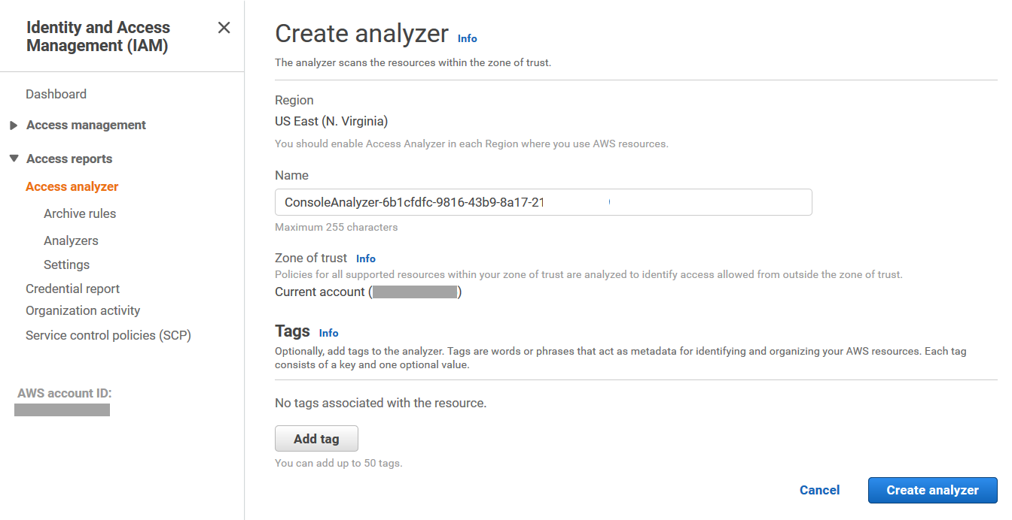
Creating an analyzer
1
Create an analyzer.
Review findings.
2
Take action.
3
Notes:
|Instructor Notes
|Student Notes
If you're using AWS resources in multiple Regions, create an analyzer in each Region where you use AWS services. Findings that are generated by an analyzer in a Region are separate from findings from analyzers in other Regions.
Zone of trust
The zone of trust for the analyzer determines the set of resources that are analyzed. Access to resources from within the zone of trust is trusted. For example, if you choose an organization, access to any resources within the organization is considered trusted for any principal within the same organization. You can create only one analyzer with an account as the zone of trust.
Tags
You can add up to 50 tags to the analyzer for your tagging strategy.
Getting started with IAM Access Analyzer
The setup process for IAM Access Analyzer involves the following steps:
Create an analyzer. You can set the scope for the analyzer to an organization or an AWS account. This is your zone of trust. The analyzer scans all the supported resources within your zone of trust.
Review active findings. When IAM Access Analyzer finds a policy that allows access to a resource from outside of your zone of trust, it generates an active finding. Findings include details about the access so that you can take action.
Take action. If the access is intended, you can archive the finding so that you can focus on reviewing active findings. If the access is not intended, you can resolve the finding by modifying the policy to remove access to the resource.

Slide 7
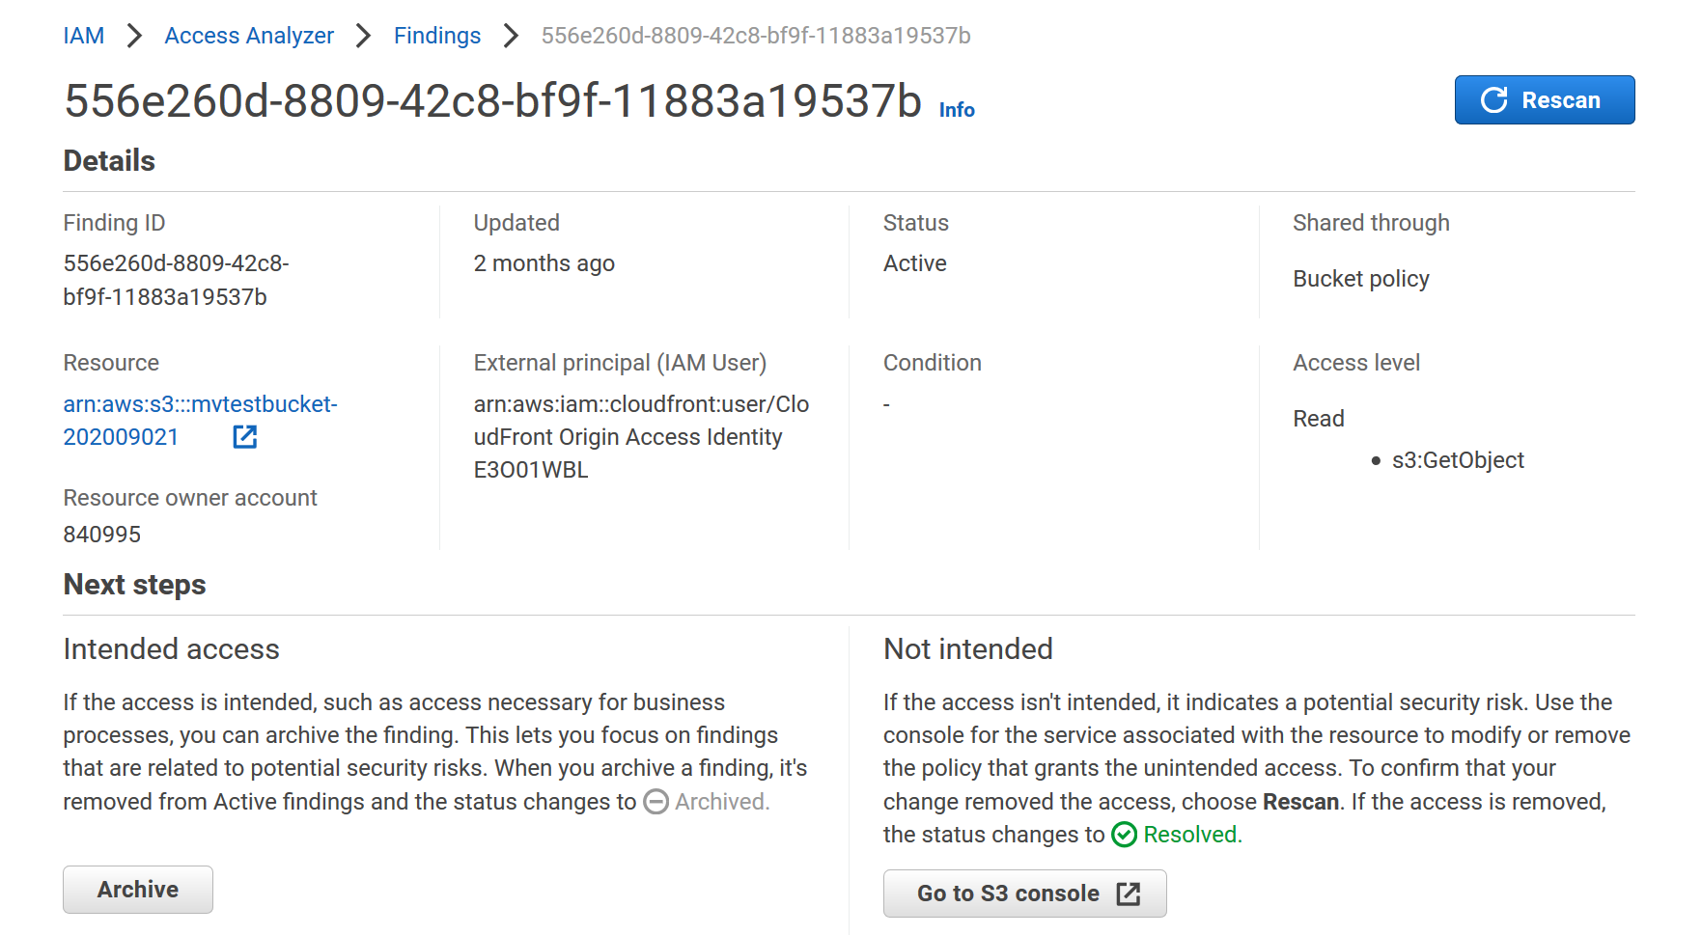
IAM Access Analyzer findings
Review findings.
Take action.
Notes:
|Instructor Notes
|Student Notes
The Findings page displays the following details about the shared resource and policy statement that generated the finding:
Finding ID – The unique ID assigned to the finding.
Resource – The type and partial name of the resource that has a policy applied to it. The policy grants access to an external entity not within your zone of trust.
Resource owner account – The account in the organization that owns the resource reported in the finding. This column is displayed only if you are using an organization as the zone of trust.
External principal – The principal, not within your zone of trust, that the analyzed policy grants access to.
Condition – The condition from the policy statement that grants the access. For example, if the Condition field includes Source VPC, the resource is shared with a principal that has access to the virtual private cloud (VPC) listed. Conditions can be global or service-specific. Global condition keys have the aws: prefix.
Shared through – The setting indicates how the access that generated the finding is granted.
Access level – The level of access granted to the external entity by the actions in the resource-based policy. View the details of the finding for more information.
Intended access – When you get a finding for access to a resource that is intentional, you can archive the finding. When you archive a finding, it is cleared from the Active findings list, so you can focus on the findings you need to resolve.
Not intended – To resolve findings generated from access that you did not intend to allow, modify the policy statement to remove the permissions that allow access to the identified resource.
For more information, see “Findings for Public and Cross-Account Access” in the AWS Identity and Access Management User Guide (https://docs.aws.amazon.com/IAM/latest/UserGuide/access-analyzer-findings.html).

Slide 8
Permissions boundary
Limit the permissions that can be granted to your IAM principals.
Use cases:
  Developers creating roles for Lambda functions
  Application owners creating roles for Amazon Elastic Compute Cloud (Amazon EC2) instances
  Administrators creating users for particular workloads
Notes:
|Instructor notes
|Student notes
Developers can create the roles that they need for their projects, but you set the maximum permissions of the roles with a permissions boundary. You can create a role, but you must attach a permissions boundary to it (in addition to the permissions policy you will attach). This allows for the safe delegation of permissions while preventing privilege escalation or broad permissions. This also allows for multiple teams in the same account to perform permissions management.
Before permissions boundaries, many of the actions listed here required developers or other personas to request roles and policies for these use cases. Some companies wouldn’t allow developers to be able to create roles because of the potential for privilege escalation. So ticketing systems or other systems were in place, which slowed down the process. Other companies went the other direction and gave developers these permissions and accepted the risk.

Slide 9



Permissions boundary workflow
Delegated
admin
Bound IAM
users and roles
Restricted
resources
Admin
Permissions
Permissions
Creates delegated
administrators
Creates bound
users and roles
Users and roles restricted by permissions boundaries
Permissions for resources are restricted
Notes:
|Instructor Notes
|Student Notes
A permissions boundary involves three entities:
Initial administrator
Delegated administrator
Objects and resources that the delegated administrator creates
The initial administrator creates the delegated administrator. This administrator attaches a policy that allows the delegated administrator to create users and roles but requires the permissions boundary to be attached.
The delegated administrator then creates users and roles and specifies the permissions boundary when creating them. Otherwise, the creation fails. The result is that the delegated administrator is allowed to create users or roles. However, the effective permissions of the principals are restricted by the permissions boundary.
Permissions boundaries do not actually grant permissions. Permissions boundaries restrict the permissions of the users and roles. Permissions of the roles attached to resources, such as Lambda functions, are limited by the permissions boundary.

Slide 10
Policy evaluation: It’s only a condition
Permissions boundary
Effective permission
Identity-based permissions
Notes:
|Instructor Notes
|Student Notes
A permissions boundary does not grant permissions. Instead, a permissions boundary restricts the permissions of the users and roles attached to it. A permissions boundary also limits the permissions of roles attached to resources, such as Lambda functions.

Slide 11
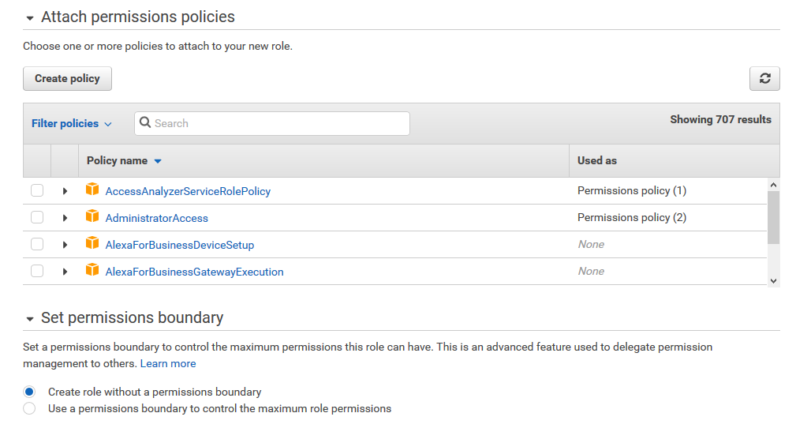
Setting up a permissions boundary
Identity-based policy slot
Permissions boundary slot
Notes:
|Instructor Notes
|Student Notes
This screenshot shows the IAM roles landing page, where you can select identity-based policies with a permissions boundary for your role.

Slide 12
Example code: Permissions boundary
Request: s3:GetObject / bucket name: example1
Identity-based policy
Permissions boundary
{
"Version": "2012-10-17",
"Statement": [
{
"Effect": "Allow",
"Action": [
"logs:CreateLogGroup",
"logs:CreateLogStream",
"logs:PutLogEvents"
],
"Resource": "*"
},
{
"Effect": "Allow",
"Action": ["s3:GetObject"],
"Resource”:"arn:aws:s3:::example1/*"
}
]
}
{
"Version": "2012-10-17",
"Statement": [
{
"Effect": "Allow",
"Action": [
"logs:CreateLogGroup",
"logs:CreateLogStream",
"logs:PutLogEvents”
],
"Resource": "arn:aws:logs:*:*:*"
}
]
}
What will happen here?
Notes:
|Instructor Notes
|Student Notes
What happens if a user with the following policies issues an s3 GetObject request? Will the request be satisfied, or will it fail?
Start with any explicit deny in any of the policies. Then, move on to the other policies. All the explicit denies from all the policies involved with an API call are evaluated first. Policies can include service control policies (SCPs), permissions boundaries, permissions policies, and resource-based policies. The API request from this example would fail at the permissions boundary. Even though the identity-based policy allows the user to issue GetObject, the permissions boundary does not mention it.
For more information, see “Policy Evaluation Logic” in the AWS Identity and Access Management User Guide (https://docs.aws.amazon.com/IAM/latest/UserGuide/reference_policies_evaluation-logic.html).

Slide 13
Detection and auditing
Notes:
|Instructor Notes
|Student Notes

Slide 14




Detection mechanisms
AWS Cloud
Account API activity
AWS CloudTrail
Resource configuration
AWS environment with resources and services
AWS Config
VPC, DNS, and AWS CloudTrail logs
Amazon GuardDuty
Amazon EC2 instance vulnerabilities
Amazon Inspector
Notes:
|Instructor Notes
|Student Notes
A foundational practice is to establish a set of detection mechanisms at the account level. This base set of mechanisms is aimed at recording and detecting a wide range of actions on all resources in your account. Using these mechanisms, you can build out a comprehensive detective capability with options that include automated remediation, and Partner integrations to add functionality.
AWS CloudTrail provides event history of your AWS account activity. Activity can include actions taken through the AWS Management Console, AWS SDKs, command line tools, and other AWS services.
AWS Config monitors and records your AWS resource configurations. You can automate the evaluation and remediation against desired configurations.
Amazon GuardDuty is a threat-detection service that continuously monitors for malicious activity and unauthorized behavior to protect your AWS accounts and workloads.
Amazon Inspector can do the following:
Perform configuration assessments against your instances for known common vulnerabilities and exposures (CVEs).
Assess against security benchmarks.
Fully automate the notification of defects.

Slide 15
AWS CloudTrail
Log and continuously monitor your account activity across your AWS infrastructure.
Record API call interactions for most AWS services.
Automatically push logs to Amazon S3.
AWS CloudTrail
Notes:
|Instructor Notes
|Student Notes
AWS CloudTrail is an AWS service that generates logs of AWS API calls. Because the AWS API underlies both the AWS Command Line Interface (AWS CLI) and the AWS Management Console, CloudTrail can record the interactions between your account’s users and resources.

Slide 16


Examples of CloudTrail logged activity
CloudTrail helps you answer questions requiring detailed analysis.
Who shut down a specific instance?
Who changed a security group configuration?
What activities were denied because of inadequate permissions?
Notes:
|Instructor Notes
|Student Notes
Using CloudTrail, you can store API activity logs in an Amazon S3 bucket. You can analyze those logs later to answer compelling questions such as the following:
Why was a long-running instance terminated, and who terminated it? (Organizational traceability and accountability)
Who changed a security group configuration? (Accountability and security auditing)
What activities were denied because of inadequate permissions? (Potential internal or external attack against the network)

Slide 17
Steps to configure CloudTrail
Create a trail.
  Name the trail.
  Select AWS Regions.
Specify a storage location.
  Create or identify the Amazon S3 bucket for log storage.
  Enable log file encryption or validation.
  Enable Amazon SNS notifications (log file delivery).
(Optional) Configure Amazon CloudWatch Logs to receive logs from CloudTrail.
Manage events.
  Define events to record (All, Reads, Writes, AWS KMS events).
AWS CloudTrail
Notes:
|Instructor Notes
|Student Notes
You can configure the following settings when you create or update a trail from the CloudTrail console or the AWS CLI. Both methods follow the same steps.
For more information, see “Creating a trail” in the AWS CloudTrail User Guide (https://docs.aws.amazon.com/awscloudtrail/latest/userguide/cloudtrail-create-a-trail-using-the-console-first-time.html ).

Slide 18
CloudTrail format: Event header
{
"eventVersion" : "1.01",
"userIdentity" : {
"type" : "IAMUser",
"principalId" : "AIDAyyyyyyyyyyyyyyyy",
"arn" : "arn:aws:iam::xxxxxxxxxxxx:user/tests3user",
"accountId" : "xxxxxxxxxxxx",
"userName" : "tests3user"
},
"eventTime" : "2020-09-23T22:41:38Z",
"eventSource" : "signin.amazonaws.com",
"eventName" : "ConsoleLogin",
"awsRegion" : "us-east-1",
"sourceIPAddress" : "54.240.217.10",
"userAgent" : "Mozilla/5.0 (Windows NT 6.1; WOW64; rv:31.0) Gecko/20100101 Firefox/31.0",
Notes:
|Instructor Notes
|Student Notes
The text in this example shows the head of a typical CloudTrail log, which is a login request. The request fully identifies the user, the time of the event, the source of the request, user agent string, and the event that occurred (ConsoleLogin).

Slide 19
CloudTrail format: Event response
"responseElements" : {
"ConsoleLogin" : "Success"
},
"additionalEventData" : {
"MobileVersion" : "No",
"LoginTo" : "https://console.aws.amazon.com/console/home?state\u003dhashArgs%23\u0026isauthcode\u003dtrue",
"MFAUsed" : "No"
},
"eventID" : "b31716e9-13e5-4fb5-9c60-1c723c59f5a6"
}
Notes:
|Instructor Notes
|Student Notes
The code example here is a continuation of the previous event and displays a successful outcome. That is, the user was able to log in successfully.

Slide 20


CloudTrail log analysis
Provides an interactive query service to analyze log data in Amazon S3 using SQL
Amazon Athena
Benefits
Serverless
Cross-Region queries are supported
Uses Presto and Apache Hive
No need to load or aggregate data
Notes:
|Instructor Notes
|Student Notes
Data investigation and research is a key phase in designing effective and efficient processing. For data stored in Amazon S3, Amazon Athena is an interactive query service that helps you to analyze data using standard structured query language (SQL). Athena is serverless, so you have no infrastructure to set up or manage. You can start analyzing data immediately. To get started, sign in to the Athena console, define your schema, and start querying. You can also access data from more than one Region in a single query.
Athena uses Presto, a distributed SQL engine, to run queries. It also uses Apache Hive to create, drop, and alter tables and partitions. You can write Hive-compliant data definition language (DDL) statements and American National Standards Institute (ANSI) SQL statements in the Athena query editor.
You can also use complex joins, window functions, and complex data types on Athena. Athena uses an approach known as schema-on-read that you can use to project your schema onto your data at the time you run a query. Schema-on-read reduces the need for any data loading or extract, transform, and load (ETL).
For more information, see “Analyzing Data in S3 Using Amazon Athena” on the AWS Big Data Blog (https://aws.amazon.com/blogs/big-data/analyzing-data-in-s3-using-amazon-athena/).

Slide 21
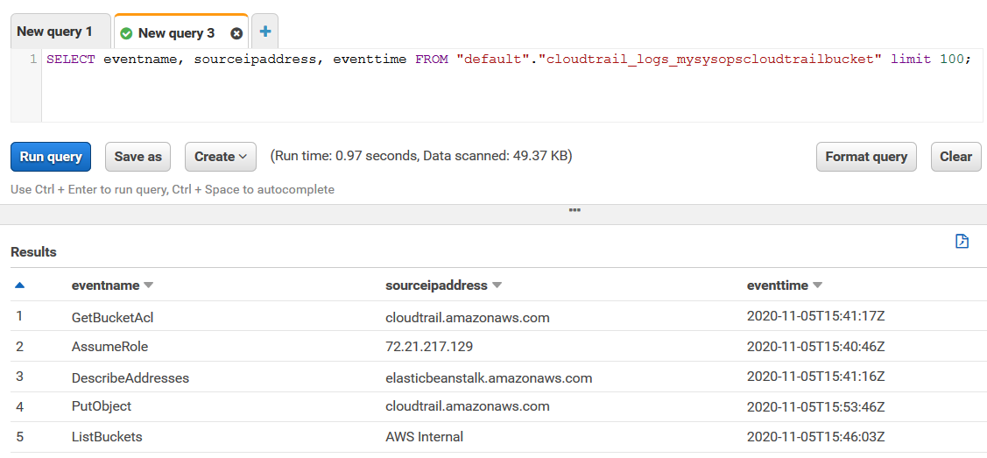
Getting started with Athena
Notes:
|Instructor Notes
|Student Notes
In Athena, tables and databases are containers for the metadata definitions. The metadata defines a schema for the underlying source data. For each Amazon S3 dataset that you select to query, you must create a table in Athena. The metadata in the table specifies where the data is located in Amazon S3. It also specifies the structure of the data—for example, column names and data types. The process of creating a table is what registers the dataset with Athena. After the table is created (automatically from the AWS Management Console or manually), you can then query the table. Athena contains a Query Editor to write and run queries.
Athena supports creating tables and querying data from files in comma-separated values (CSV), tab-separated values (TSV), custom-delimited, and JSON formats. Files from Hadoop-related formats, such as the following, are also supported:
Optimized Row Columnar (ORC)
Apache Avro and Parquet
Logstash logs
CloudTrail logs
Apache WebServer logs
Properly configure Athena according to the format being queried. This way, Athena knows which format is used and how to parse the data.
For more information, see “Supported SerDes and Data Formats” in the Amazon Athena User Guide (https://docs.aws.amazon.com/athena/latest/ug/supported-serdes.html).

Slide 22
AWS Config
Continuously captures details on all configuration changes associated with your resources
Provides compliance monitoring and security analysis
Sends notifications when changes occur
Automates remediation
AWS Config
Notes:
|Instructor Notes
|Student Notes
AWS Config is a continuous monitoring and assessment service that provides you with an inventory of your AWS resources and records changes to the configuration of those resources. You can view the current and historic configurations of a resource and use this information to troubleshoot outages and conduct analyses of security attack. You can view the configuration at any time. Use that information to reconfigure your resources and bring them into a steady state during an outage situation.
AWS resources are entities that you create and manage by using the AWS Management Console, the AWS CLI, the AWS SDKs, or AWS Partner tools. Examples of AWS resources include the following:
Amazon EC2 instances
Security groups
Amazon Redshift clusters
Amazon Virtual Private Cloud (Amazon VPC) components
Amazon Elastic Block Store (Amazon EBS)
AWS Config refers to each resource using its unique identifier, such as the resource ID or an Amazon Resource Name (ARN). AWS Config also integrates with AWS Systems Manager to provide continuous monitoring and governance of software on your EC2 instances. It also monitors on-premises systems, such as your virtual machines (VMs).
AWS Config also includes multi-account, multi-Region data aggregation to provide centralized auditing and governance. This feature reduces the time and overhead needed to gather an enterprise-wide view of your compliance status.
For more information, see the following in the AWS Config Developer Guide:
“Multi-Account Multi-Region Data Aggregation” (https://docs.aws.amazon.com/config/latest/developerguide/aggregate-data.html)
“Supported Resource Types” (http://docs.aws.amazon.com/config/latest/developerguide/resource-config-reference.html)

Slide 23


AWS Config rules
Managed rules
Defined and maintained by AWS
Require minimal to no configuration
Custom rules
Uses Lambda functions
Maintained by the customer
Administrator
Notes:
|Instructor Notes
|Student Notes
Using AWS Config rules, you can run continuous assessment checks on your resources to verify that they comply with your own security policies, industry best practices, and compliance standards.
Managed rules
AWS provides several managed, prebuilt rules that require minimal to no configuration. For example, AWS Config provides a rule to ensure that encryption is turned on for all Amazon EBS volumes in your account.
Examples of managed rules include the following:
Are all attached EBS volumes encrypted?
Do all EC2 instances belong to a VPC?
Are all resources tagged as expected?
Do all security groups in use deny unregulated, incoming Secure Shell (SSH) traffic?
Is CloudTrail enabled in your AWS account?
Does the password policy for IAM users meet specified requirements?
Custom rules
You can also write a custom AWS Config rule to codify your own corporate security policies. Custom rules are associated with a Lambda function that you create and maintain. When you invoke a custom rule, it runs the associated Lambda function. AWS Config alerts you in real time when a resource is misconfigured or when a resource violates a particular security policy.
For more information, see “AWS Config Managed Rules” in the AWS Config Developer Guide (http://docs.aws.amazon.com/config/latest/developerguide/evaluate-config_use-managed-rules.html).

Slide 24
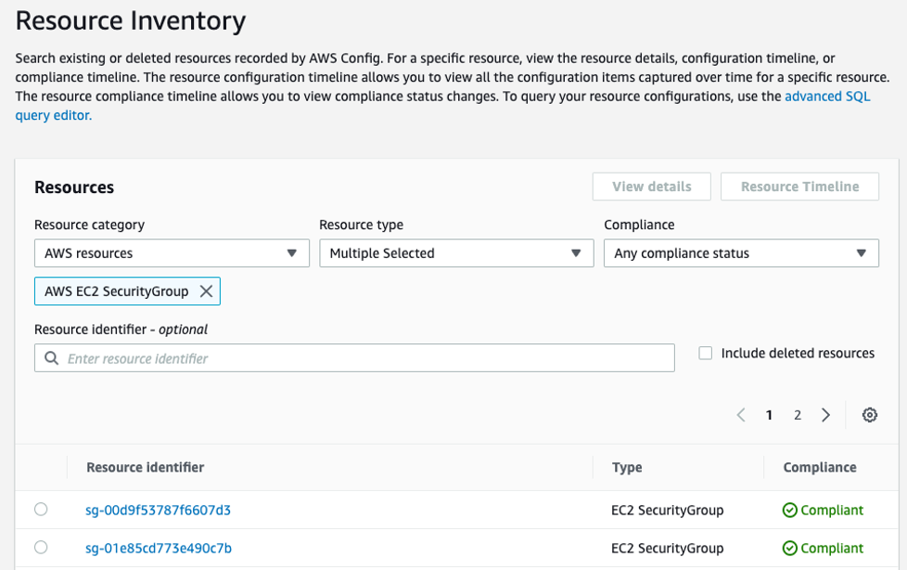
Implementing AWS Config rules
Notes:
|Instructor Notes
|Student Notes
The Resource inventory user interface contains the results from the AWS Config rules that you have set up. You can view results by resource type, tag, or compliance status. Expanding one of the entries displays the reason that the specific resource type is compliant or noncompliant. Selecting the resource link provides detailed information for the resource, such as relationships, any past configuration changes, ARN, and CloudTrail events.

Slide 25
Amazon GuardDuty
Intelligent threat detection and continuous monitoring to protect AWS accounts and workloads
Identifies suspected malicious activity through integrated threat intelligence feeds
Uses machine learning to detect anomalies
Amazon GuardDuty
Notes:
|Instructor Notes
|Student Notes
Amazon GuardDuty is an intelligent threat detection service that provides you with a way to continuously monitor and protect your AWS accounts and workloads. GuardDuty identifies suspected unauthorized users through integrated threat intelligence feeds. It uses machine learning to detect anomalies in account and workload activity.
GuardDuty monitors for activity such as unusual API calls or unauthorized deployments that indicate a customer’s accounts might have been compromised. It also monitors direct threats, such as compromised instances or reconnaissance by unauthorized users or third parties. When GuardDuty detects a potential security risk, the service delivers a detailed security alert to the GuardDuty console and Amazon EventBridge. The delivery of this information makes alerts actionable and capable of integrating into existing event management and workflow systems.
To learn more Amazon GuardDuty, see Continuous Monitoring and Threat Detection at https://aws.amazon.com/security/continuous-monitoring-threat-detection/.

Slide 26



Getting started with GuardDuty
CloudTrail Events
Account 1
Account 2
VPC Flow Logs
Account 3
DNS Logs
Turn on GuardDuty for all accounts.
Continuously analyze data.
Intelligently detect threats.
Take action with detailed findings.
Notes:
|Instructor Notes
|Student Notes
You can turn on GuardDuty in the AWS Management Console with a few steps. When enabled, the service immediately starts analyzing events from CloudTrail, Amazon VPC Flow Logs, and Domain Name System (DNS) logs. AWS Security creates, maintains, and updates the detections, rule sets, and threat intelligence, so that you do not have to write rules or detection logic.
When GuardDuty detects a potential threat, it delivers a detailed security finding to the GuardDuty console and EventBridge. This makes alerts actionable and easy to integrate into existing event management or workflow systems. The findings include the category, resource affected, and metadata associated with the resource. Metadata might include tags, a severity level, an explanation of the finding, and suggested remediation path.
GuardDuty consumes feeds from various sources, such as the following:
AWS (CloudTrail Events, Amazon VPC Flow Logs, and DNS Logs)
Third-party security providers
Open-source feeds
Customer-provided threat intelligence

Slide 27
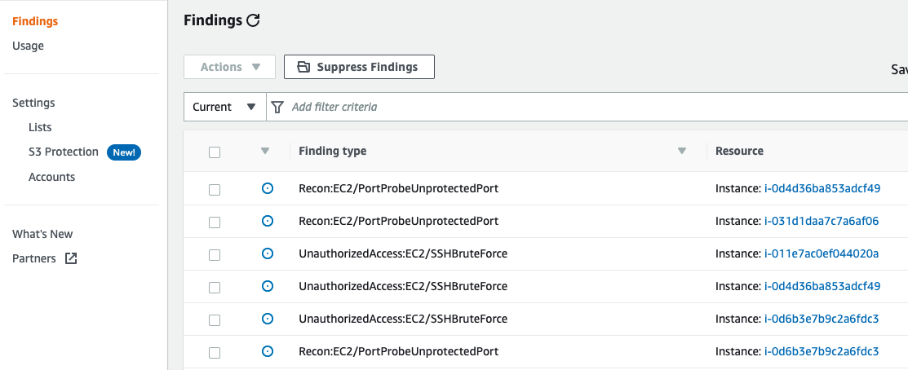
GuardDuty findings
Notes:
|Instructor Notes
|Student Notes
When GuardDuty detects a threat, the service delivers a detailed security finding to the GuardDuty console and EventBridge. The findings details include the following:
Information about what happened
Which AWS resources were involved in suspicious activity
When and where the activity took place
Who was the actor
GuardDuty findings come in a common JSON format that is also used by Amazon Macie and Amazon Inspector. By using JSON format, customers and Partners can consume security findings from all three services and incorporate them into broader event management, workflow, or security solutions. You can view and manage the findings through the Findings page in the web console. You can also use the AWS CLI or API operations (ListFindings).
Severity levels indicate a security issue that can result in compromised information confidentiality, integrity, and availability within your AWS infrastructure. GuardDuty findings have an assigned severity level of high, medium, or low.
A high severity level means that you treat the security issue as a priority and take immediate remediation steps.
A medium level calls for an investigation of the implicated resource at your earliest convenience.
A low severity level indicates that there is no immediate recommended action. However, it is worth noting this information as something to address in the future.
With GuardDuty, you can set up automatic archiving when creating a findings filter. This is useful when you have the following situations:
A unique use case in your environment generates many similar findings.
You have reviewed a certain class of findings and don’t want to be alerted again.
For information, see “Remediating Security Issues Discovered by GuardDuty” in the Amazon GuardDuty User Guide (https://docs.aws.amazon.com/guardduty/latest/ug/guardduty_remediate.html).

Slide 28




GuardDuty use case
AWS Cloud
Findings
Malicious IP detected
Modify network ACL
VPC
Invoke
GuardDuty
Amazon EventBridge
EventBridge rule
Lambda
EC2 instance
being probed
Notes:
|Instructor Notes
|Student Notes
With GuardDuty, EventBridge, and Lambda, you have the flexibility to set up automated preventative actions based on a security finding. For example, you can create a Lambda function to modify your firewall or network access control list (network ACL) rules based on security findings. If a GuardDuty finding indicates that one of your EC2 instances is being probed by a known malicious IP, you can address it through a EventBridge rule. The rule launches a Lambda function to automatically modify your firewall or network ACL rules and restrict access on that port.

Slide 29
Amazon Inspector
Automated assessments that help improve security and compliance of applications
Detects vulnerabilities
Verifies security best practices
Generates findings report
Offers both agent-based and agentless solutions
Amazon Inspector
Notes:
|Instructor Notes
|Student Notes
Amazon Inspector is an automated security assessment service that helps improve the security and compliance of applications deployed on AWS. Amazon Inspector automatically assesses applications for vulnerabilities or deviations from best practices.
After performing an assessment, Amazon Inspector produces a detailed list of security findings ranked by level of severity. You can review these findings directly or as part of detailed assessment reports that are available from the Amazon Inspector console or using API operations. Because Amazon Inspector is an agent-based service, you can deploy the Amazon Inspector agent on the EC2 instances running the applications that you want to assess. Amazon Inspector also offers agentless network assessments with the Network Reachability rules package. Network Reachability identifies ports and services on your EC2 instances that are accessible from outside your VPC.

Slide 30
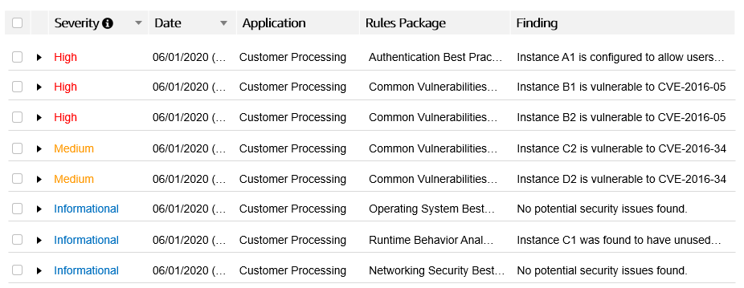
Example: Amazon Inspector findings
Notes:
|Instructor Notes
|Student Notes
Amazon Inspector finds applications by querying the package manager or software installation system on the operating system where the agent is installed. This means that software that was installed through the package manager is assessed for vulnerabilities.
Note: Limitations and restriction on methods of installation recognized by Amazon Inspector include the following:
Amazon Inspector assesses software installed through APT, YUM, or Microsoft Installer.
Amazon Inspector does not assess software installed through the following:
make config/make install
Binary files copied directly to the system using automation software, such as Puppet or Ansible
Reports
An assessment report is a document that details what is tested in the assessment run, and the results of the assessment. The results of your assessment are formatted into standard reports. You can generate the reports to share results within your team for remediation actions, to enrich compliance audit data, or to store for future reference. You can generate an Amazon Inspector assessment report for an assessment run when it has been successfully completed. You can select from two types of report for your assessment: a findings report or a full report.
The findings report contains a summary of the following:
Assessment
Instances targeted
Rules packages tested
Rules that generated findings
Detailed information about each of these rules along with the list of instances that failed the check
The full report contains all the information in the findings report. The report also provides a list of rules that passed on all instances in the assessment target.

Slide 31
Incident response and automated remediation
Notes:
|Instructor Notes
|Student Notes

Slide 32
Incident response overview
Educate
Iterate
Prepare
Automate
remediation
Simulate
Notes:
|Instructor Notes
|Student Notes
Even with extremely mature preventive and detective controls, your company should still implement mechanisms to respond to and mitigate the potential impact of security incidents. Your preparation strongly affects your team’s ability to operate effectively during an incident, to isolate and contain issues, and to restore operations to a known good state.
Educate your security operations and incident response staff about cloud technologies and how your organization intends to use them.
Prepare your incident response team to detect and respond to incidents in the cloud, enable detective capabilities, and ensure that appropriate access is given to the necessary tools and cloud services. Additionally, prepare the necessary runbooks, both manual and automated, to ensure reliable and consistent responses. Work with other teams to establish expected baseline operations, and use that knowledge to identify deviations from those normal operations. An Automation runbook defines the actions that Systems Manager performs on your managed instances and other AWS resources when an automation runs. Automation is a capability of AWS Systems Manager.
Simulate both expected and unexpected security events in your cloud environment to understand the effectiveness of your preparation.
Iterate on the outcome of your simulation to improve the scale of your response posture, reduce time to value, and further reduce risk.
The focus of this section is on automating remediation.
For more information, see “Incident Response” in Security Pillar of the AWS Well-Architected Framework (https://docs.aws.amazon.com/wellarchitected/latest/security-pillar/incident-response.html).

Slide 33

Common remediation options
Remediate
Playbooks
AWS Config
Automation
Other detection
findings
Amazon EventBridge
Lambda function
Notes:
|Instructor Notes
|Student Notes
Create incident response plans as playbooks, starting with the most likely scenarios for your workload and company. These might be events that are currently generated. AWS Config detects a change in compliance, and it can use Automation (predefined and custom) to remediate. If you need to use a Lambda function to remediate, AWS Config can initiate a Amazon EventBridge event, and the EventBridge event can launch a Lambda function. Use EventBridge events to initiate remediation in the form of Automation, Lambda, and several other target functions.

Slide 34
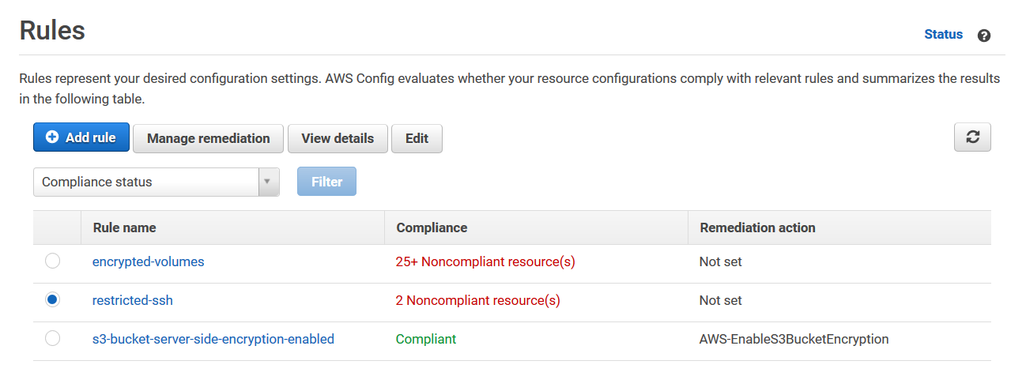
Managing AWS Config rule remediation
You can add remediation actions.
Remediation is already assigned.
Notes:
|Instructor Notes
|Student Notes
Use AWS Config to remediate noncompliant resources that are evaluated by AWS Config rules. AWS Config applies remediation by using Automation documents. These documents define the actions to be performed on noncompliant AWS resources evaluated by AWS Config rules.
For more information, see “Remediating Noncompliant Resources with AWS Config Rules” in the AWS Config Developer Guide (https://docs.aws.amazon.com/config/latest/developerguide/remediation.html).

Slide 35
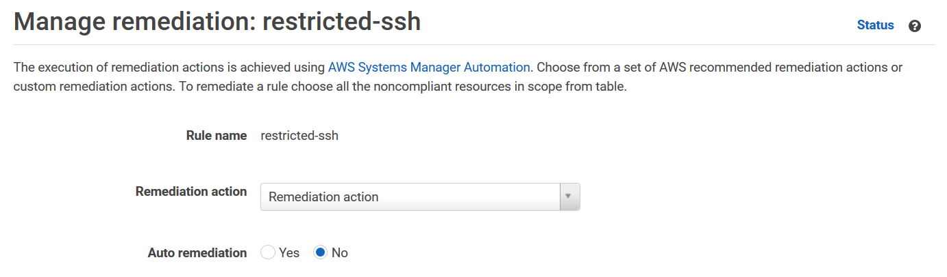
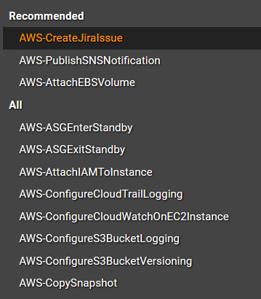
Setting up a remediation action
Automatic or manual
Select an
Automation document
(predefined or custom).
Notes:
|Instructor Notes
|Student Notes
AWS Config provides a set of managed Automation documents with remediation actions. You can also create and associate custom Automation documents with AWS Config rules.
Predefined or custom Automation documents
To apply remediation on noncompliant resources, you can choose the remediation action from a prepopulated list, or create your own custom remediation actions using Systems Manager documents. AWS Config provides a recommended list of remediation actions in the AWS Config Console.
Manual or automatic remediation
In the AWS Management Console, you can choose to manually or automatically remediate noncompliant resources by associating remediation actions with AWS Config rules. With all remediation actions, you can choose manual or automatic remediation.

Slide 36

AWS Lambda for incident response
Run your code on demand without provisioning or managing servers.
Securely access other AWS services.
Use IAM roles to provide permissions.
Use security groups and network ACLs.
Invoke AWS functions.
Notes:
|Instructor Notes
|Student Notes
With Lambda, you can run code without provisioning or managing servers. You can run code for virtually any type of application or backend service, all with no administration. You can set up your code to be automatically invoked from other AWS services or call it directly from any web or mobile app.
The code that you run on Lambda is called a Lambda function. Functions are modular. Instead of having one function called file processor that does compression, thumb nailing, and indexing, consider having three different functions, where each function does one task. After you create your Lambda function, it is always ready to run as soon as it is initiated.
Lambda functions are stateless, with no affinity to the underlying infrastructure. This means that Lambda can rapidly launch as many copies of the function as needed to scale to the rate of incoming events. After you upload your code to Lambda, you can associate your function with specific AWS resources (for example, a particular Amazon SNS notification).
Then, when the resource changes, Lambda runs your function and manages the compute resources as needed to keep up with incoming requests. If you need to store secrets to access external services, you can use the AWS Key Management Service (AWS KMS) to store and retrieve the secrets within your Lambda function.

Slide 37
Allowing actions
IAM role
Allowed
action
Lambda function
Trust policy allows Lambda to assume an IAM role.
IAM policy permissions specify which actions Lambda is allowed.
Notes:
|Instructor Notes
|Student Notes
Lambda allows your code to securely access other AWS services through its built-in AWS SDK and integration with IAM. You grant permissions to your Lambda function to access other resources using an IAM role. Lambda assumes the role while running your Lambda function, so you always retain full and secure control of exactly which AWS resources it can use.
Lambda runs your code within a VPC by default. You can also configure Lambda to access resources behind your own VPC. You can use custom security groups and network ACLs to provide your Lambda functions access to your resources within a VPC. Lambda is compliant with Security Operations Center (SOC), Health Insurance Portability and Accountability Act (HIPAA), Payment Card Industry (PCI), and International Organization for Standardization (ISO).

Slide 38

Example: Lambda for incident response
Issues StopLogging request on the account
User
AWS CloudTrail
Amazon EventBridge
Lambda
Amazon SNS
Remediates the issue by starting the logging
Receives notification with only the required information
Response analyst
Notes:
|Instructor Notes
|Student Notes
With an event-driven response system, a detective mechanism invokes a responsive mechanism to automatically remediate the event. You can use event-driven response capabilities to reduce the time-to-value between detective mechanisms and responsive mechanisms. To create this event-driven architecture, you can use Lambda. For example, assume that you have an AWS account with the CloudTrail service enabled. If CloudTrail is ever disabled, the response procedure is to enable the service again and investigate the user who disabled the CloudTrail logging.
You can use Eventbridge to monitor for the specific cloudtrail:StopLogging event and run the function if it occurs. When EventBridge invokes this Lambda function, the function collects the following details of the specific event:
Information of the principal who disabled CloudTrail
When it was disabled
Specific resource that was affected
Other relevant information
This processed information could then be sent as an Amazon SNS notification. You can use this information to essentially perform a log dive and then generate a notification or alert with only the specific values that a response analyst would require. Another Lambda function can also be invoked to automatically start the logging.

Slide 39
Example Corp. manager request 1
Maintain a strong identity and access foundation.
Why is it important to use IAM Access Analyzer?
What are the scenarios for which you would want to use permissions boundaries?
Notes:
|Instructor Notes
|Student Notes

Slide 40
Example Corp. manager request 2
Implement detection mechanisms.
How do you detect and investigate security events?
Which AWS services would you use for detection in your environment?
Notes:
|Instructor Notes
|Student Notes

Slide 41
Example Corp. manager request 3
Automate incident remediation.
How do you anticipate, respond to, and recover from incidents?
How can AWS Config and Automation help you automate your remediation efforts?
How can you invoke Lambda functions for remediation?
Notes:
|Instructor Notes
|Student Notes

Slide 42
Troubleshooting
Notes:
|Instructor Notes
|Student Notes

Slide 43
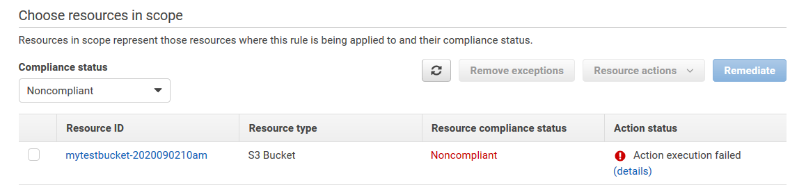
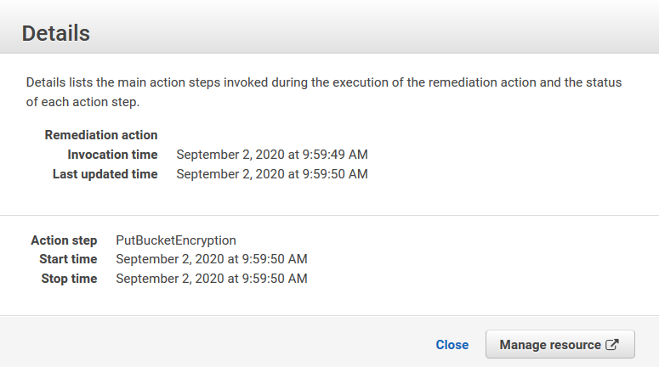
Troubleshooting scenario
AWS Config rule:
s3-bucket-server-side-encryption-enabled
With automatic remediation configured
Remediation failed on S3 bucket mytestbucket-2020090210am
Where do you find more information?
Notes:
|Instructor Notes
|Student Notes
You have configured the AWS Config rule, s3-bucket-server-side-encryption-enabled, to detect buckets with encryption disabled. You configured the AWS Config rule with automatic remediation using the Automation document AWS-EnableS3BucketEncryption. Your bucket, mytestbucket-2020090210am, is marked as noncompliant, and the remediation action has generated an error. The details page does not include all information on the cause of the error. Where do you find more information?
Because Automation manages remediation, you will find more details on the processed Automation documents in the Automation console.

Slide 44
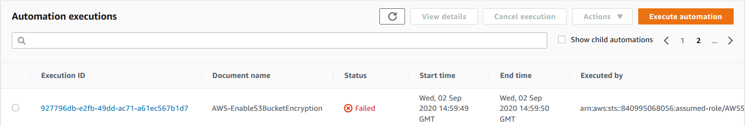
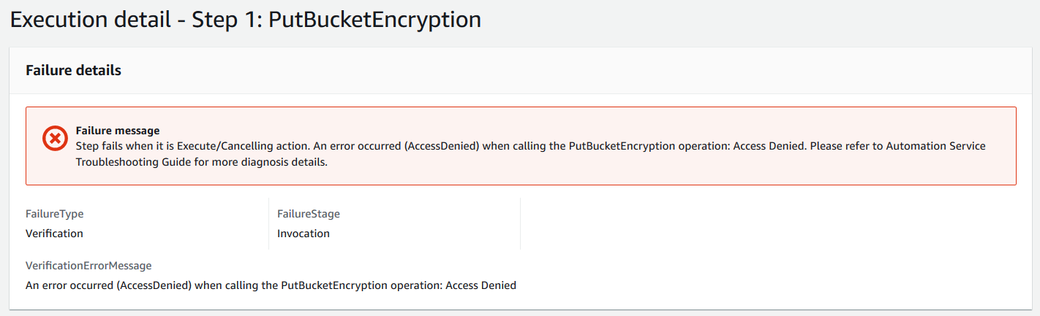
Automation console
Notes:
|Instructor Notes
|Student Notes
Because the remediation is an Automation document, you can find more information about enacted documents in the Automation console. You will find a list of processed automations. Find the Automation document in the list, and open it for more details. In this example, the Execution detail steps have an AccessDenied error.
The following are the most likely causes for the errors:
S3 Encryption permissions missing
iam::PassRole policy is missing

Slide 45
Troubleshooting with AWS CLI
For more detailed error messages, run this command:
aws configservice describe-remediation-execution-status \
--config-rule-name example-rule \
--region example-region \
--resource-keys resourceType=example-resource-type,resourceId=example-resource-ID
Note: Replace example-rule, example-region, example-resource-type, and example-resource-ID with your information.
Notes:
|Instructor Notes
|Student Notes
You can use the AWS CLI to find detailed information about AWS Config remediation errors.
For more information, see “How Can I Troubleshoot Failed Remediation Actions in AWS Config?” in the AWS Knowledge Center (https://aws.amazon.com/premiumsupport/knowledge-center/config-remediation-executions/).

Slide 46
AWS CLI output
{
"RemediationExecutionStatuses": [
{
"ResourceKey": {
"resourceType": "AWS::S3::Bucket",
"resourceId": "mytestbucket-2020090210am"
},
"State": "FAILED",
"StepDetails": [
{
"Name": "PutBucketEncryption",
"State": "FAILED",
"ErrorMessage": "Step fails when it is Execute/Cancelling action. An error occurred (AccessDenied) when calling the PutBucketEncryption operation: Access Denied. Please refer to Automation Service Troubleshooting Guide for more diagnosis details.",
"StartTime": "2020-09-02T09:59:50.127000-05:00",
"StopTime": "2020-09-02T09:59:50.494000-05:00"
}
],
"InvocationTime": "2020-09-02T09:59:49.865000-05:00",
"LastUpdatedTime": "2020-09-02T09:59:50.943000-05:00"
}
]
}
Notes:
|Instructor Notes
|Student Notes
This example shows the output of the error.

Slide 47
Summary
In this module, we discussed the following:
Maintaining a strong identity and access foundation
Implementing detection mechanisms
Automating incident remediation
Notes:
|Instructor Notes
|Student Notes

Slide 48
Thank you
Corrections, feedback, or other questions?
Contact us at https://support.aws.amazon.com/#/contacts/aws-training.
All trademarks are the property of their owners.
Notes:
|Instructor Notes
|Student Notes

Slide 49
AWS CLI output
{
"RemediationExecutionStatuses": [
{
"ResourceKey": {
"resourceType": "AWS::S3::Bucket",
"resourceId": "mytestbucket-2020090210am"
},
"State": "FAILED",
"StepDetails": [
{
"Name": "PutBucketEncryption",
"State": "FAILED",
"ErrorMessage": "Step fails when it is Execute/Cancelling action. An error occurred (AccessDenied) when calling the PutBucketEncryption operation: Access Denied. Please refer to Automation Service Troubleshooting Guide for more diagnosis details.",
"StartTime": "2020-09-02T09:59:50.127000-05:00",
"StopTime": "2020-09-02T09:59:50.494000-05:00"
}
],
"InvocationTime": "2020-09-02T09:59:49.865000-05:00",
"LastUpdatedTime": "2020-09-02T09:59:50.943000-05:00"
}
]
}
Notes:
|Instructor Notes
|Student Notes
This example shows the output of the error.

