Slide 1
Cloud Operations on AWS
Module 13:
Object Storage
Notes:
|Instructor notes
|Student Notes

Slide 2
Module overview
Course scenario
Deploying Amazon Simple Storage Service (Amazon S3)
Managing storage lifecycles on Amazon S3
Notes:
|Instructor Notes
|Student Notes

Slide 3
Example Corp. manager requests
Optimize data storage.
Back up your data.
Set up a data lifecycle plan.
Notes:
|Instructor Notes
|Student Notes
As costs for cloud resources climb, you are asked to develop a plan to optimize data storage and data lifecycle management. This plan must include classifying data. You also need to establish lifecycle storage rules according to the data classification and plan for backup and recovery scenarios.

Slide 4
Amazon S3
Notes:
|Instructor Notes
|Student Notes

Slide 5



Amazon S3 overview
Client
Amazon S3
Is built to store and retrieve object data
Provides key-based access to objects
Provides a fast, durable, and highly available service
Is not a file system
Object
returned
Object
requested
Bucket with objects
Notes:
|Instructor Notes
|Student Notes
In Module 12, you were primarily concerned with the storage used by your Amazon Elastic Compute Cloud (Amazon EC2) compute instances and the day-to-day operational issues. These issues are related to ensuring that the instances have the necessary storage performance capacity and data-protection safeguards to ensure smooth compute functionality. The data stored, accessed, and processed locally by your EC2 instances is usually data that is undergoing frequent changes.
For the rest of this module, we will focus on more long-term, lower-cost storage options, which are provided by Amazon Simple Storage Service (Amazon S3).
Amazon S3 provides highly available and durable storage of data that is primarily static. This is not data that is undergoing frequent changes due to the requirements of your applications. Instead, it is data that many users or applications might need to retrieve, download, and process locally.
Amazon S3 and Amazon Simple Storage Service Glacier (Amazon S3 Glacier) also provide low-cost storage solutions for storing snapshots and other data backup and recovery solutions.

Slide 6
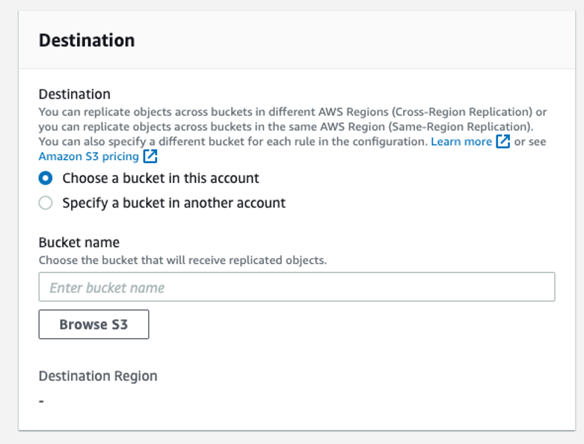
Amazon S3 replication
Objects are automatically replicated across Availability Zones.
Automate replication to other buckets using replication rules.
Enable S3 Same-Region Replication (SRR) or S3 Cross-Region Replication (CRR).
Notes:
|Instructor Notes
|Student Notes
For Amazon Elastic Block Store (Amazon EBS) volumes, you are responsible for setting up snapshots to replicate your Amazon EC2 data. By contrast, Amazon S3 automatically copies your data to other Amazon Web Services (AWS) Availability Zones in an AWS Region without any intervention from you.
You can set up replication rules that create additional copies of your data to ensure increased availability and accessibility. You can automate the copying of an S3 bucket’s contents to a secondary bucket in the same Region. You can also copy its contents to a different Region, where the data will again be replicated across the Availability Zones in that Region. You can use S3 Cross-Region Replication (CRR) to increase fault tolerance and reduce latency for users in other Regions. You can set up replication rules through the Amazon S3 console, as shown here.
After the replication rule is in place, no further action on your part is needed. Every time a new object is placed in the S3 bucket, it is replicated according to the rule.
For more information, see “When to Use Cross-Region Replication” in the Amazon Simple Storage Service User Guide at https://docs.aws.amazon.com/AmazonS3/latest/dev/replication.html#crr-scenario.

Slide 7
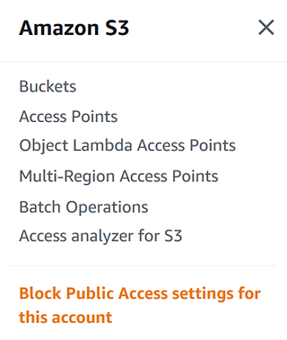
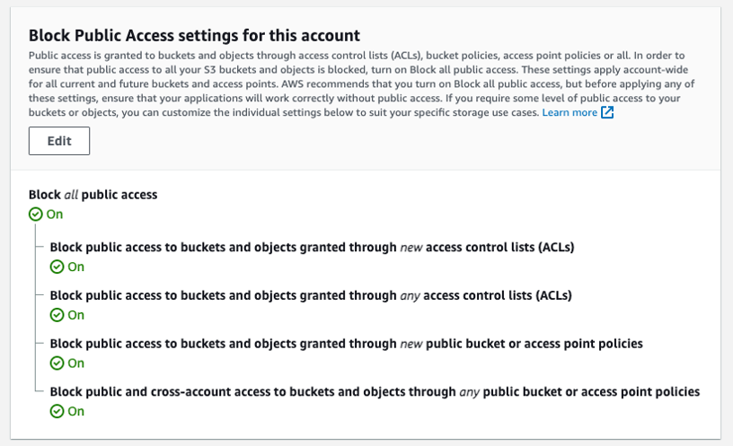
Settings for S3 Block Public Access
Set at account level
Set at individual bucket level
Notes:
|Instructor Notes
|Student Notes
S3 Block Public Access prevents the application of any settings that allow public access to data in S3 buckets. You can configure S3 Block Public Access settings for an individual S3 bucket or for all the buckets in your account.
Block all public access – Turning this setting on is the same as turning on all of the following four settings. Each of the settings is independent from the another.
Block public access to buckets and objects granted through new access control lists (ACLs) – Amazon S3 blocks public access permissions applied to newly added buckets or objects. It prevents the creation of new public ACLs for existing buckets and objects. The setting does not modify any existing permissions that allow public access to Amazon S3 resources using ACLs.
Block public access to buckets and objects granted through any access control lists (ACLs) – Amazon S3 ignores all ACLs that grant public access to buckets and objects. This setting overrides any current or future public access settings for current and future objects in the bucket.
Block public access to buckets and objects granted through new public bucket or access point policies – Amazon S3 blocks new bucket and access point policies that grant public access to buckets and objects. This setting does not modify any existing policies that allow public access to Amazon S3 resources.
Block public and cross-account access to buckets and objects through any public bucket or access point policies – Amazon S3 ignores public and cross-account access for buckets or access points with policies that grant public access to buckets and objects.
For information, see “Blocking Public Access to Your Amazon S3 Storage” in the Amazon Simple Storage Service User Guide at https://docs.aws.amazon.com/AmazonS3/latest/dev/access-control-block-public-access.html.

Slide 8
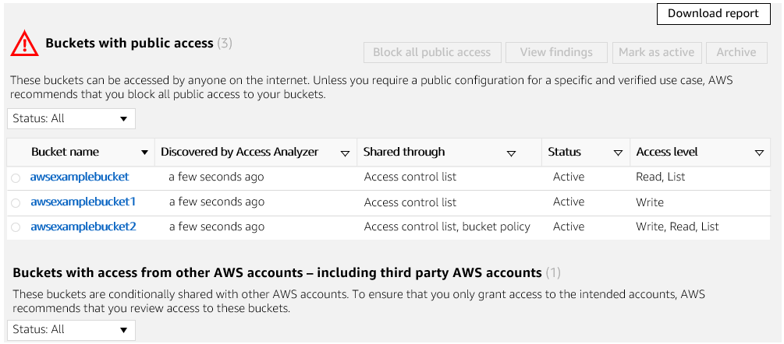
Access Analyzer for S3
Notes:
|Instructor Notes
|Student Notes
Access Analyzer for S3 alerts you to S3 buckets that allow access to anyone on the internet or other AWS accounts, including AWS accounts outside of your organization. For each public or shared bucket, you receive findings into the source and level of public or shared access. For example, Access Analyzer for S3 might show that a bucket has read or write access provided through a bucket ACL, a bucket policy, or an access point policy. Armed with this knowledge, you can take immediate and precise corrective action to restore your bucket access to what you intended.
For more information, see “Reviewing Bucket Access Using IAM Access Analyzer for S3” in the Amazon Simple Storage Service User Guide at https://docs.aws.amazon.com/AmazonS3/latest/user-guide/access-analyzer.html.

Slide 9
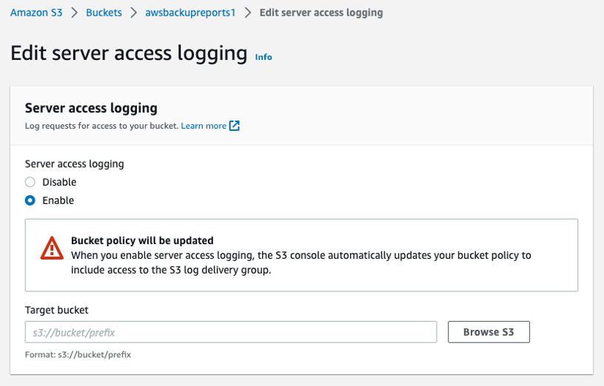
S3 Access Logs
Enable server access logging.
Specify the destination bucket.
Notes:
|Instructor Notes
|Student Notes
Server access logging provides detailed records for the requests that are made to a bucket. S3 Access Logs are useful for many applications. For example, access log information can be useful in security and access audits. It can also help you learn about your customer base and understand your Amazon S3 bill.
For more information, see “Amazon S3 Server Access Log Format” in the Amazon Simple Storage Service User Guide at https://docs.aws.amazon.com/AmazonS3/latest/dev/LogFormat.html.

Slide 10
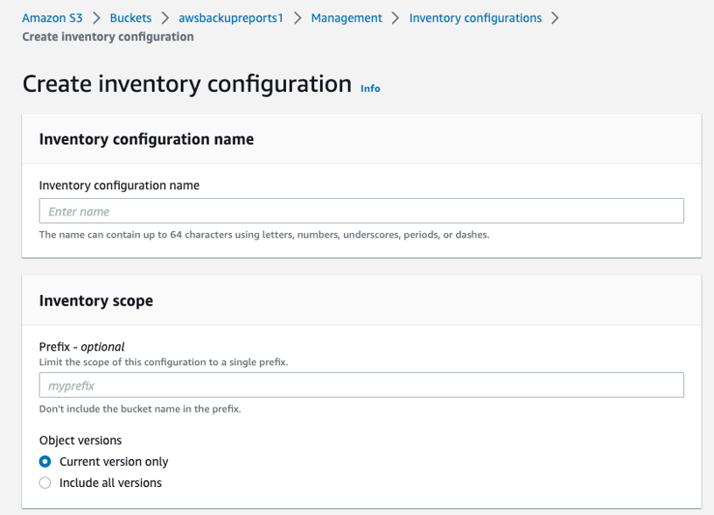
Amazon S3 inventory
Notes:
|Instructor Notes
|Student Notes
Use Amazon S3 Inventory to automate report generation that details the contents and status of objects in an S3 bucket.
You can use S3 inventory to audit and report on the replication and encryption status of your objects for business, compliance, and regulatory needs.

Slide 11

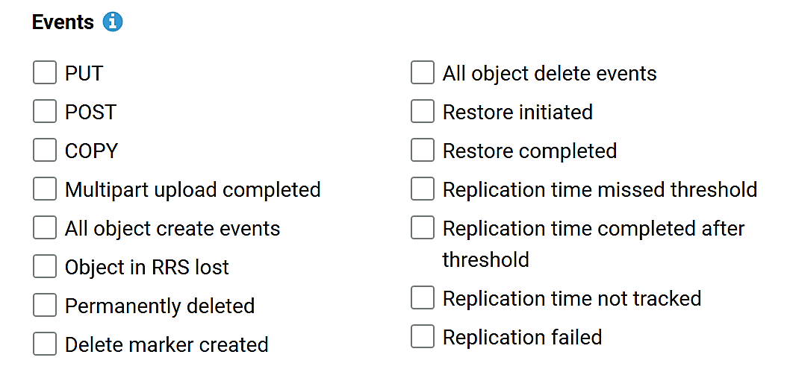


S3 Event Notifications
Amazon SQS queue
Amazon SNS topic
Bucket notification options
AWS Lambda function
Notes:
|Instructor Notes
|Student Notes
You can use the Amazon S3 Event Notifications feature to receive notifications when certain events happen in your S3 bucket. Currently, Amazon S3 can publish notifications for the following events:
New object created events
Object removal events
Restore object events
Reduced Redundancy Storage (RRS) object lost events
Replication events
S3 Lifecycle expiration events
S3 Lifecycle transition events
S3 Intelligent-Tiering automatic archival events
Object tagging events
Object ACL PUT events
Amazon S3 can send event notification messages to the following destinations:
Amazon Simple Notification Service (Amazon SNS) topics
Amazon Simple Queue Service (Amazon SQS) queues
AWS Lambda function
Amazon EventBridge
When configuring these notifications, you can also use prefix and suffix filters to opt in to event notifications based on object name. For example, you can choose to receive DELETE notifications for the images/ prefix and the .png suffix in a particular bucket.
To use this feature with your application, follow these steps.
Create the queue, topic, or Lambda function (which we will call target for brevity), if necessary.
Grant Amazon S3 permission to publish to the target or invoke the Lambda function. For Amazon SNS or Amazon SQS, you do this by applying an appropriate policy to the topic or the queue. For Lambda, you must create and supply an IAM role, then associate it with the Lambda function.
Arrange for your application to be invoked in response to activity on the target.
Set the bucket’s Notification Configuration to point to the target.
For more information, see “Amazon S3 Event Notifications” in the Amazon Simple Storage Service User Guide at https://docs.aws.amazon.com/AmazonS3/latest/dev/NotificationHowTo.html.

Slide 12
S3 Versioning
Protects from accidental overwrites and deletes with no performance penalty
Versioning Enabled | Versioning Not Enabled or Versioning Suspended
 | Deletes the object. It is no longer retrievable.
Version 3
Upload object with the same key
Version 2
Version 3
Version 1
Version 3
Delete
Version 2
Version 1
Marked deleted
but is still available
Notes:
|Instructor Notes
|Student Notes
S3 Versioning protects from accidental overwrites and deletes with no performance penalty.
Versioning includes the following features:
Generates a new version with every upload.
Deletes are logical deletes only. Objects are not removed from the bucket.
Allows retrieval of deleted objects or a rollback to previous versions.
An S3 bucket has three states as follows:
Default no versioning:
Upload an object to a bucket with the same key. It overwrites the earlier version.
Delete an object, and it is permanently deleted.
Versioning enabled:
Upload an object with the same key. Amazon S3 keeps the earlier object and creates a new object with a new version ID.
Delete an object, and Amazon S3 logically deletes it and adds a marker. However, the earlier version is retrievable by its version ID.
Versioning suspended:
Versions of objects are maintained, but the bucket temporarily behaves as it does when the bucket version is disabled.
When enabled, you cannot disable it.
You can only suspend it. All versions created previously remain.
Buckets with versioning suspended behave like buckets that do not have versioning enabled.

Slide 13
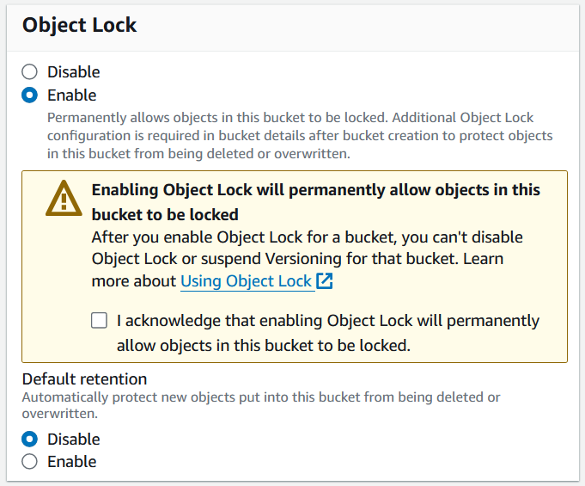
S3 Object Lock mode
Store objects using the write-once-read-many (WORM) model.
Configure Object Lock at the bucket or object level.
Apply legal holds at the object level:
S3 Object Lock must be enabled
Independent from retention periods
Notes:
|Instructor Notes
|Student Notes
With S3 Object Lock, you can store objects using the write-once-read-many (WORM) model. Using S3 Object Lock, you can prevent an object from being deleted or overwritten for a fixed amount of time or indefinitely. With S3 Object Lock, you can meet regulatory requirements that require WORM storage or add an additional layer of protection against object changes and deletion.
S3 Object Lock provides two ways to manage object retention: retention periods and legal holds. They are defined as follows:
Retention period – Specifies a fixed period of time during which an object remains locked. During this period, your object will be WORM-protected and can't be overwritten or deleted.
Legal hold – Provides the same protection as a retention period but has no expiration date. Instead, a legal hold remains in place until you explicitly remove it.
Retention modes
S3 Object Lock provides two retention modes: governance and compliance. You can apply either retention mode to any object version that is protected by S3 Object Lock. The modes are defined as follows:
Compliance mode – A protected object version cannot be overwritten or deleted by any user, including the root user in your AWS account. When an object is locked in compliance mode, its retention mode cannot be changed, and its retention period cannot be shortened.
Governance mode – Users cannot overwrite or delete an object version or alter its lock settings unless they have special permissions. In governance mode, you can protect objects against deletion by most users. However, you can continue to grant some users permission to alter the retention settings or delete the object if necessary.

Slide 14
Amazon S3 tiers and lifecycle rules
Notes:
|Instructor Notes
|Student Notes

Slide 15






Traditional S3 storage classes
Higher cost, frequent access
Lower cost, infrequent access
S3 Standard
S3 Standard-IA
S3 One Zone-IA
S3 Glacier Instant Retrieval
S3 Glacier Flexible Retrieval
S3 Glacier Deep Archive
Active, frequently accessed data
No minimum storage duration charge
Infrequently accessed objects
30 day minimum storage duration charge
Recreatable, less accessed data
30 day minimum storage duration charge
Archived data that needs fast restore times
90 day minimum storage duration charge
Objects with unpredictable restore needs
90 day minimum storage duration charge
Archive data not likely to be restored
180 day minimum storage duration charge
S3 Intelligent-Tiering – Data with unknown or changing access patterns. Milliseconds to access.
Notes:
|Instructor Notes
|Student Notes
Amazon S3 offers a range of storage classes designed for different use cases. These include the following:
S3 Standard for general-purpose storage of frequently accessed data.
S3 Standard-Infrequent Access (S3 Standard-IA) for long-lived, but less frequently accessed data.
S3 One Zone-Infrequent Access (S3 One Zone-IA) for long-lived, less frequently accessed data that can be stored in a single Availability Zone.
S3 Glacier Instant Retrieval for archive data that is rarely accessed but requires a restore in milliseconds.
S3 Glacier Flexible Retrieval for the most flexible retrieval options that balance cost with access times ranging from minutes to hours. Your retrieval options permit you to access all the archives you need, when you need them, for one low storage price. This storage class comes with multiple retrieval options:
Expedited retrievals (restore in 1–5 minutes).
Standard retrievals (restore in 3–5 hours).
Bulk retrievals (restore in 5–12 hours). Bulk retrievals are available at no additional charge.
S3 Glacier Deep Archive for long-term cold storage archive and digital preservation. Your objects can be restored in 12 hours or less.
S3 Intelligent-Tiering is an additional storage class that provides flexibility for data with unknown or changing access patterns. It automates the movement of your objects between storage classes to optimize cost.
Amazon S3 also offers capabilities to manage your data throughout its lifecycle. When an S3 Lifecycle policy is set, your data automatically transfers to a different storage class without any changes to your application.
For more information, see each of the following resources:
“Amazon S3 Storage Classes” at https://aws.amazon.com/s3/storage-classes
“Performance Across the S3 Storage Classes” at https://aws.amazon.com/s3/storage-classes/#Performance_across_the_S3_Storage_Classes

Slide 16
Storage class: S3 Intelligent-Tiering
Frequent Access tier
Accessed in the past 30 days ($$$$)
Infrequent Access tier
S3 Intelligent-Tiering
Not accessed in the past 30 days ($$$)
Archive Instant Access tier
Not accessed in the past 90 days, low latency ($$)
Monitor access patterns.
Move objects.
1
Archive Access tier
Not accessed in the past 90 days ($$)
2
Deep Archive Access tier
Not accessed in the past 180 days ($)
Notes:
|Instructor Notes
|Student Notes
The S3 Intelligent-Tiering storage class is designed to optimize cost savings by automatically moving data to the most cost-effective access tier when access patterns change.
Criteria for moving objects
Objects uploaded or transitioned to S3 Intelligent-Tiering are automatically stored in the Frequent Access tier.
S3 Intelligent-Tiering works by monitoring access patterns and moving the objects that have not been accessed in 30 consecutive days to the Infrequent Access tier. After 90 consecutive days of no access, objects are moved to the Archive Instant Access tier.
If you activate one or both asynchronous archive access tiers, S3 Intelligent-Tiering automatically moves objects that haven’t been accessed for 90 consecutive days to the Archive Access tier. After 180 consecutive days of no access, objects are moved to the Deep Archive Access tier. If the objects are accessed later, S3 Intelligent-Tiering moves the objects back to the Frequent Access tier.
No retrieval fees are incurred when using the S3 Intelligent-Tiering storage class. No additional tiering fees are incurred when objects are moved between access tiers. It is the designed to be the ideal storage class for long-lived data with access patterns that are unknown or unpredictable.
You can configure Amazon S3 storage classes at the object level. A bucket can contain objects stored in S3 Standard, S3 Intelligent-Tiering, S3 Standard-IA, and S3 One Zone-IA. You can upload objects directly to S3 Intelligent-Tiering or use S3 Lifecycle policies to transfer objects from S3 Standard and S3 Standard-IA to S3 Intelligent-Tiering. You can also archive objects from S3 Intelligent-Tiering to S3 Glacier.

Slide 17




S3 Express One Zone storage class
Availability Zone
VPC
AWS SDK
Optional: Co-locate compute resources in same Availability Zone
Session based auth
Fast access
Single-AZ architecture
Machine learning and artificial intelligence training
Interactive data analytics
High performance computing (HPC)
Financial modeling
Real-time advertising
Media content workloads
Single-digit millisecond first-byte P99 latency
S3 directory buckets
Low-latency use cases
Notes:
|Instructor Notes (2 min)
|Purpose : convey new Amazon S3 Express One Zone information
|better supports leveraging object storage in low latency use cases
|single AZ
|fast connectivity – session based auth token
|fast object access - single-digit ms. 1st byte p99
|file system-likeness – directory buckets
|prefixes not needed – performance improvement
|compatible with various AWS compute (EC2, ECS, EKS)
|Important: S3 Express is not compatible with other Amazon S3 storage classes.
|Does not work any other S3 storage classes including Intelligent Tiering or Lifecycle Policies.
|Very specific use cases for the low first byte latency.
|
|
|Student Notes
Amazon S3 Express One Zone is a new implementation of object storage.
From an architectural difference, S3 Express One Zone is implemented in a single Availability Zone. It implements a session based authentication token to allow clients to connect quickly to the storage service. To provide the lowest latency, you can co-locate your compute resources in the same Availability Zone.
S3 Express One Zone supports EC2 instances, ECS containers, and EKS containers for compute.
S3 Express One Zone implements directory buckets. Directory buckets provide file system like directory structure to your S3 Express One Zone buckets. This provides fast access with virtually unlimited number of objects per directory and removes the use of prefixes to improve performance.
The S3 Express One Zone changes enable consistent single-digit millisecond first-byte P99 latency to improve application efficiency and performance.
The access and latency improvements enable use case that require low latency and can have thousands of clients accessing a large common data pool.
For more information, go to “Amazon S3 Express One Zone features”:
https://aws.amazon.com/s3/storage-classes/express-one-zone/
https://aws.amazon.com/blogs/aws/new-amazon-s3-express-one-zone-high-performance-storage-class/

Slide 18
S3 Lifecycle configurations
S3 Standard-IA
S3 Intelligent-Tiering
S3 One Zone-IA
S3 Standard
S3 Glacier Instant Retrieval
Configure rules to transition objects to lower Amazon S3 storage classes.
S3 Glacier Flexible Retrieval
S3 Glacier Deep Archive
Notes:
|Instructor Notes
|Student Notes
To manage your objects so they are stored cost-effectively throughout their lifecycle, configure their S3 Lifecycle. An S3 Lifecycle configuration is a set of rules that define actions that Amazon S3 applies to a set of objects. You can apply the rules at bucket level or according to an object’s tags.
Amazon S3 supports a waterfall model for transitioning between storage classes, as shown in the diagram.
For more information, see “Transitioning Objects Using Amazon S3 Lifecycle” in the Amazon Simple Storage Service User Guide at https://docs.aws.amazon.com/AmazonS3/latest/dev/lifecycle-transition-general-considerations.html.

Slide 19
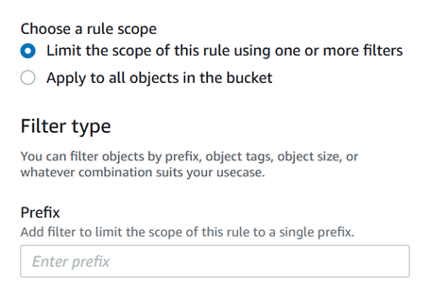
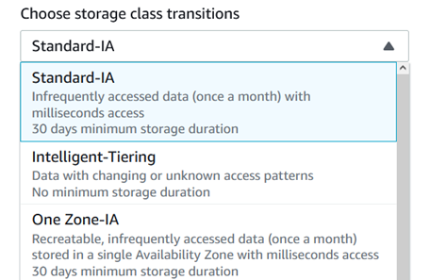
Amazon S3 Lifecycle actions
Set target
Select action
Use S3 Lifecycle actions to transition or expire objects.
Notes:
|Instructor Notes
|Student Notes
You can use S3 Lifecycle policies to define actions that you want Amazon S3 to take during an object's lifetime. For example, you can transition objects to another storage class, archive them, or delete them after a specified period.
You can define an S3 Lifecycle policy for all objects or for a subset of objects by using a shared prefix (object names that begin with a common string) or a tag.
To apply this lifecycle rule to all objects with a specific prefix, choose Limit the scope of this rule using one or more filters. In the Prefix box, enter the prefix or tag name.
For more information, see “Managing Your Storage Lifecycle” in the Amazon Simple Storage Service User Guide at https://docs.aws.amazon.com/AmazonS3/latest/userguide/object-lifecycle-mgmt.html.
When an object reaches the end of its lifetime, Amazon S3 queues it for removal and removes it asynchronously. There might be a delay between the expiration date and the date when Amazon S3 removes an object. You are not charged for storage time associated with an object that has expired.

Slide 20

Amazon S3 Glacier Storage classes
S3 Glacier Instant Retrieval
S3 Glacier Flexible Retrieval
S3 Glacier
Deep Archive
Archival storage
Low cost
Retrieval options
Instant
By request
Amazon S3 Glacier
Notes:
|Instructor Notes
|Student Notes
The S3 Glacier Instant Retrieval, S3 Glacier Flexible Retrieval, and S3 Glacier Deep Archive storage classes are designed for low-cost data archiving. These storage classes are designed for different access patterns and storage duration. These storage classes differ as follows.
S3 Glacier Instant Retrieval – Use this storage class for archiving data that is rarely accessed and requires retrieval in milliseconds. Data stored in the S3 Glacier Instant Retrieval storage class offers a cost savings compared to the S3 Standard-IA storage class with the same latency and throughput performance as the S3 Standard-IA storage class. S3 Glacier Instant Retrieval has higher data access costs than S3 Standard-IA.
S3 Glacier Flexible Retrieval – Use this storage class for archives where portions of the data might need to be retrieved in minutes. Data stored in the S3 Glacier Flexible Retrieval storage class has a minimum storage duration period of 90 days and can be accessed in as little as 1–5 minutes using expedited retrieval. The retrieval time is flexible, and you can request free bulk retrievals in up to 5–12 hours. If you have deleted, overwritten, or transitioned an object to a different storage class before the 90-day minimum, you are charged for 90 days.
S3 Glacier Deep Archive – Use this storage class for archiving data that rarely needs to be accessed. Data stored in the S3 Glacier Deep Archive storage class has a minimum storage duration period of 180 days and a default retrieval time of 12 hours. If you have deleted, overwritten, or transitioned an object to a different storage class before the 180-day minimum, you are charged for 180 days.

Slide 21

Restoring an archived object
Object(s)
Number of days
Retrieval tier
Restore request
1
Initiate a restore request.
2
Wait for restore completion.
3
Access the restored object.
GET
Notes:
|Instructor Notes
|Student Notes
Amazon S3 objects in the following storage classes or tiers are archived and are not accessible in real time:
The S3 Glacier Flexible Retrieval storage class
The S3 Glacier Deep Archive storage class
The S3 Intelligent-Tiering Archive Access tier
The S3 Intelligent-Tiering Deep Archive Access tier
To restore the objects, you must do the following:
For objects in the S3 Intelligent-Tiering Archive Access and Deep Archive Access tiers, you must initiate the restore request and wait until the object is moved into the Frequent Access tier. If the object is not accessed after 30 consecutive days, it automatically moves into the Infrequent Access tier. It moves into the S3 Intelligent-Tiering Archive Access tier after a minimum of 90 consecutive days of no access. It moves into the Deep Archive Access tier after a minimum of 180 consecutive days of no access.
For objects in the S3 Glacier Flexible Retrieval and S3 Glacier Deep Archive storage classes, you must initiate the restore request and wait until a temporary copy of the object is available. Amazon S3 restores a temporary copy of the object only for the specified duration. After that specified time, it deletes the restored object copy.

Slide 22
Archive retrieval options
Check progress in the console or receive Amazon SNS notification.
Specify the restoration expiry date for restored objects.
 | Expedited | Standard (With Batch Operations) | Standard (Without Batch Operations) | Bulk
S3 Glacier Flexible Retrieval S3 Intelligent-Tiering Archive Access | 1–5 minutes | Minutes–5 hours | 3–5 hours | 5–12 hours
S3 Glacier Deep Archive S3 Intelligent-Tiering Deep Archive Access | Not available | 9–12 hours | Within 12 hours | Within 48 hours
Notes:
|Instructor Notes
|Student Notes
Amazon S3 objects that are stored in the S3 Glacier Flexible Retrieval or S3 Glacier Deep Archive storage classes are not immediately accessible. To access an object in these storage classes, you must restore a temporary copy of it to its S3 bucket for a specified duration (number of days).
Restored objects from S3 Glacier Flexible Retrieval or S3 Glacier Deep Archive are stored only for the number of days that you specify. If you want a permanent copy of the object, create a copy of it in your S3 bucket.
Archive retrieval options
You can specify one of the following when initiating a job to retrieve an archive based on your access time and cost requirements:
Expedited – With Expedited retrievals, you can quickly access your data when occasional urgent requests for a subset of archives are required. For all but the largest archives (more than 250 MB), data accessed using expedited retrievals are typically made available within 1–5 minutes. Two types of Expedited retrievals are provided: On-Demand and Provisioned. On-Demand requests are similar to Amazon EC2 On-Demand Instances and are available most of the time. Provisioned requests are available when you need them.
Standard – With standard retrievals, you can access any of your archives within several hours. Standard retrievals typically complete within 3–5 hours. This is the default option for retrieval requests that do not specify the retrieval option. Standard retrievals initiated by using the S3 Batch Operations restore operation typically start within minutes. They finish within 3–5 hours for objects stored in the S3 Glacier Flexible Retrieval storage class or S3 Intelligent-Tiering Archive Access tier.
Bulk – Bulk retrievals are the lowest-cost retrieval option in Amazon S3 Glacier. You can retrieve large amounts, even petabytes, of data inexpensively in a day. Bulk retrievals typically complete within 5–12 hours.
For more information about archive retrieval options, see “Archive Retrieval Options” in the Amazon Simple Storage Service User Guide at https://docs.aws.amazon.com/AmazonS3/latest/userguide/restoring-objects-retrieval-options.html.

Slide 23
Example Corp. manager request 1
Optimize data storage.
Why is it important to have different Amazon S3 storage classes available?
Which factors will you consider when selecting an Amazon S3 storage class?
What are your biggest opportunities to optimize your data storage?
Notes:
|Instructor Notes
|Student Notes

Slide 24
Example Corp. manager request 2
Set up a data lifecycle management plan.
How do you manage the lifecycle of your Amazon S3 storage?
How do you manage the lifecycle of your data storage?
Notes:
|Instructor Notes
|Student Notes

Slide 25
Summary
In this module, we discussed the following:
Deploying Amazon S3
Managing storage lifecycles on Amazon S3
Notes:
|Instructor notes
|Student notes

Slide 26
Thank you
Corrections, feedback, or other questions? Contact us at https://support.aws.amazon.com/#/contacts/aws-training. All trademarks are the property of their owners.
Notes:
|Instructor Notes
|Student Notes

